Slide 1

Computer Networks (CET2005B)
School of Computer Engineering and Technology (SCET)

Slide 2

Computer Networks
Teaching Scheme Credits: 3 + 1 = 4
Theory: 3 Hrs / Week Practical: 2 Hrs / Week
Course Objectives:
1. Knowledge:
i. To understand the fundamentals of networking and data communications.
ii. To understand network & data link layer protocols.
2. Skills: i. To learn network layer protocols.
3. Attitude:
i. To explore services offered by the transport layer.
ii. To understand protocols of the application layer
Course Outcomes:
On completion of course, students should be able to
1. Identify characterizing features of transmission techniques.
2. Recall and Demonstrate working of flow control & error control protocols.
3. Select routing protocol to Develop fully-functional simulation to simulate its working.
4. Define connection oriented & connectionless transport layer protocols & build working applications based on it.
5. Choose application layer protocol and make use of it in a suitable environment.

Slide 3
Syllabus
1 | Fundamentals of networking and data communication (9 Hrs) Analog Transmission: Analog-to-Analog conversion, Digital-to-Analog conversion, Digital Transmission: Digital-to-Digital conversion (line coding, block coding, scrambling), Analog-to-Digital conversion (Pulse Code Modulation, Delta Modulation) Types of Networks, Network Architectures, Network Topologies, Transmission media’s, Networking devices, OSI Model, TCP/IP Reference Model, Ethernet standards.
2 | Data Link Layer: (9 Hrs) Data Link Layer Services, Types of errors, Block coding, Error Control: Cyclic Redundancy Check (CRC) Code, Hamming Code, Checksum, sliding window Protocols: Selective Repeat (SR) & Go Back N (GBN), Channel allocation, Multiple Access Protocols: ALOHA, CSMA/CD, CSMA/CA, Ethernet Frame format.
3 | Network Layer (9 Hrs) Services, Internet Protocol: Ipv4 & Ipv6, Classful Addressing, Classless Addressing, CIDR, Subnetting, NAT, ARP, RARP, ICMP, Routing Algorithms: Distance-Vector (DV) Routing, Link State (LS) Routing, Routing in Internet: RIP, OSPF, BGP
4 | Transport Layer (9 Hrs) Services, Multiplexing, demultiplexing. Sockets, UDP, RTP, TCP: Services, Features, Segment, TCP Connection (Three-Way Handshake), Flow control and buffering, Silly window syndrome, Congestion Control. Congestion Control (Leaky Bucket, Token Bucket), Quality of Service (QoS)
5 | Application Layer (9 Hrs) Dynamic Host Control Protocol (DHCP), Hypertext Transfer Protocol (HTTP), FTP, TELNET, SMTP: POP3, IMAP, MIME, Domain Name System (DNS), SNMP.

Slide 4
Guidelines for CCA and LCA
Examination Scheme
CCA Marks Distribution
Sr. No. | Examination Scheme | Marks
1. | Class Continuous Assessment (CCA) | 30
2. | Laboratory Continuous Assessment (LCA) | 30
3. | Term End Examination | 40
Sr. No. | Class Continuous Assessment: (30 Marks) | Marks
1. | Mid Term Exam | 15
2. | Active Learning | 10
3. | Theory Assignment Component | 05
Sr. No. | Laboratory Continuous Assessment: (30 Marks) | Marks
1. | Practical Performance | 10
2. | Implementation | 10
3. | End Term Practical/ Oral Examination | 10

Slide 5
Lab Assignment
Design a simple network (LAN) with different topologies & test it using PING utility.
Analyze and test PCM modulation technique.
Design and configure a virtual LAN.
Write a program for error detection and correction codes using Hamming Codes
Write a program to implement subnetting to find subnet mask
Implement Static and Dynamic NAT Configuration with Packet Tracer
Set up a network - configure interfaces, IP addresses and routing protocols (RIP, OSPF, EIGRP, BGP).
Write a C program for wired network using TCP socket to demonstrate a) Chat Application (50% Students) b) Mathematical operations. (Remaining 50% Students) Show packet captured traces using Wireshark Packet Analyzer Tool.
UDP Socket Programming: (Language: C/C++/Python/Java)/ Write a C program for wired network using UDP socket to perform any one of the following operations.
a. String Conversion from UpperCase to LowerCase. (50% Students)
b. Reverse the String. (Remaining 50% Students) Show packet captured traces using Wireshark Packet Analyzer Tool.
Configure network using Dynamic Host Configuration Protocol (DHCP), DNA and Web server Use Ping utility to
test connectivity.

Slide 6

Syllabus Module 2: Data Link Layer:
Data Link Layer Services.
Types of errors.
Block coding.
Error Control: Cyclic Redundancy Check (CRC) Code, Hamming Code, Checksum.
Sliding window Protocols: Selective Repeat (SR) & Go Back N (GBN)
Channel allocation, Multiple Access Protocols: ALOHA, CSMA/CD, CSMA/CA
Ethernet Frame format.

Slide 7
1. Data transmitted in Data link layer is in:
Packets
Frames
Segments
Electromagnetic signals
Frames
2. Which of the following are the services of Data link layer?
Encapsulation of packets into frames
Error control
QoS control
Flow control
All of the above
All of the above

Slide 8
3 Is IS-IS a Data link layer protocol?
Yes
No
Yes
4 Which of the following is the Layer 2 protocol?
IP
IPX
OSPF
RIPv2
None of the above
None of the above
5 Media Access control (MAC) which is 48 bits work at ____ layer
Layer 1
Layer 2
Layer 3
Layer 4
Layer 2

Slide 9
6. The Data link layer is concerned with?
Delivery of Packets
Local delivery of frames between devices on the LAN segment
Internal delivery of segments
None of the above
Local delivery of frames between devices on the LAN segment
7. What is error control in Data link layer of OSI model?
Retransmission of erroneous packets
Transmission of erroneous packets
Controlled erroneous packet transmission with encryption
None
Retransmission of erroneous packets

Slide 10
9. In which layer of OSI do mechanisms include to detect and recover transmission error?
Application layer
Transport layer
Physical layer
Data link layer
Data link layer
10. Virtual LAN is a service of ____layer
Local layer
Network Layer
Transport Layer
Data link layer
Data link layer
11. HDLC (High-Level Data Link Control) and SDLC (Synchronous Data Link Control) operate at layer___.
1
2
3
4
2

Slide 11
Unit III: Network Layer
Services
Internet Protocol: Ipv4 & Ipv6
Classful Addressing, Classless Addressing, CIDR (Classless Inter Domain Routing)
Subnetting
NAT, ARP, RARP, ICMP
Routing Algorithms: Distance-Vector (DV) Routing, Link State (LS) Routing
Routing in Internet: RIP, OSPF, BGP.

Slide 12
Learning Resources:
Text Books:
1. Behrouz A. Forouzan, ‘Data Communications and Networking’, 5th Edition, McGrawHill Publishing Company,
ISBN 978-0-07-337622-6
2. Tanenbaum A. S., ‘Computer Networks’, Pearson Education, 5th Edition, ISBN-978-0-13-212695-3
Reference Books:
1. James F. Kurose and Keith W Ross ‘Computer Networking, A Top-Down Approach’, 5th Edition, Pearson
Education, ISBN- 978-81-317-9054-0
2. W. Richard Stevens, Unix Network Programming, The Sockets Networking API, Vol 1, 3rd Edition, PHI
Learning Pvt. Ltd.
Supplementary Reading:
1. William Stallings, ‘Data and Computer Communications’, 6th Edition, Prentice Hall of India Pvt.

Slide 13
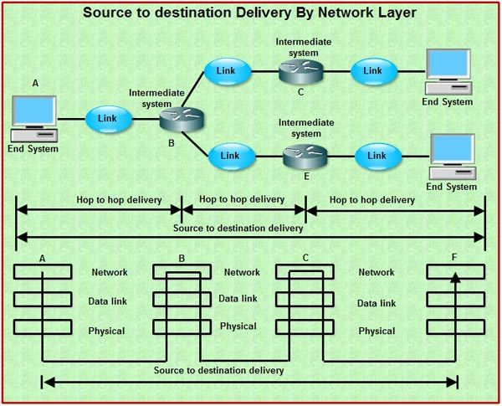
Functionality of Network Layer
Internetworking: Facilitates interconnection between heterogeneous networks.
Addressing: Defines logical addressing (IP) so that any endpoint can be identified.
Routing: Defines the most optimum path the packet should take from the source to the destination.
Packetizing: Implements routing of frames (packets) through the network.
Congestion: Handles congestion in the network.
Fragmenting: The network layer also defines how to fragment a packet into smaller packets to accommodate different media.
Host to Host delivery

Slide 14
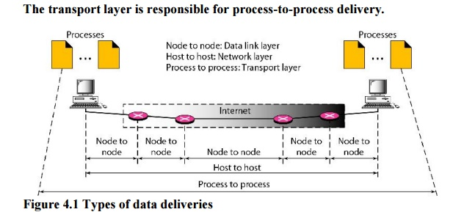

Slide 15
Functions of Network Layer
Routing:
The network layer protocols determine which route is suitable from source to destination. This function of the network layer is known as routing.
Logical Addressing:
In order to identify each device on internetwork uniquely, the network layer defines an addressing scheme.
The sender & receiver’s IP addresses are placed in the header by the network layer. Such an address distinguishes each device uniquely and universally.
Segment in Network layer is referred to as Packet.
Network layer is implemented by networking devices such as routers.

Slide 16
Network Layer Services
Packetizing
Routing and Forwarding
Implements routing of frames (packets) through the network.
Defines the most optimum path the packet should take from the source to the destination.
Addressing: Defines logical addressing so that any endpoint can be identified.
Facilitates interconnection between heterogeneous networks (Internetworking).
Defines how to fragment a packet into smaller packets to accommodate different media
Error Control

Slide 17
Network Layer Services (Cntd.)
Flow Control
Congestion Control: Handles congestion in the network.
Quality of Service
Security
Guaranteed delivery
Guaranteed delivery with bounded delay
In-order packet delivery
Guaranteed minimal bandwidth
Guaranteed maximum jitter

Slide 18
Network Layer Design Issues
Store-and-Forward Packet Switching
Services Provided to the Transport Layer
Implementation of Connectionless Service
Implementation of Connection-Oriented Service
Datagram and Virtual-Circuit Subnets

Slide 19
Services provided to the Transport Layer
The services should be independent of the router technology.
The transport layer should be shielded from the number, type, and topology of the routers present.
The network addresses made available to the transport layer should use a uniform numbering plan, even cross LANs and WANs.

Slide 20
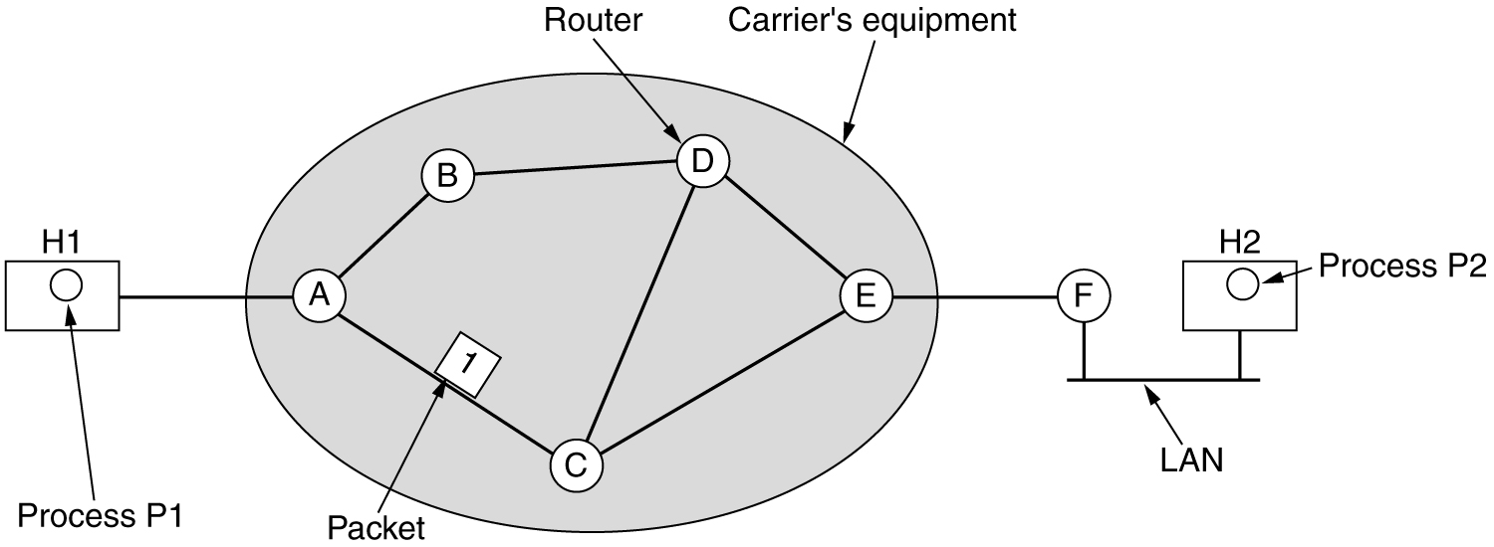
Store-and-Forward Packet Switching
Environment of network layer protocols

Slide 21
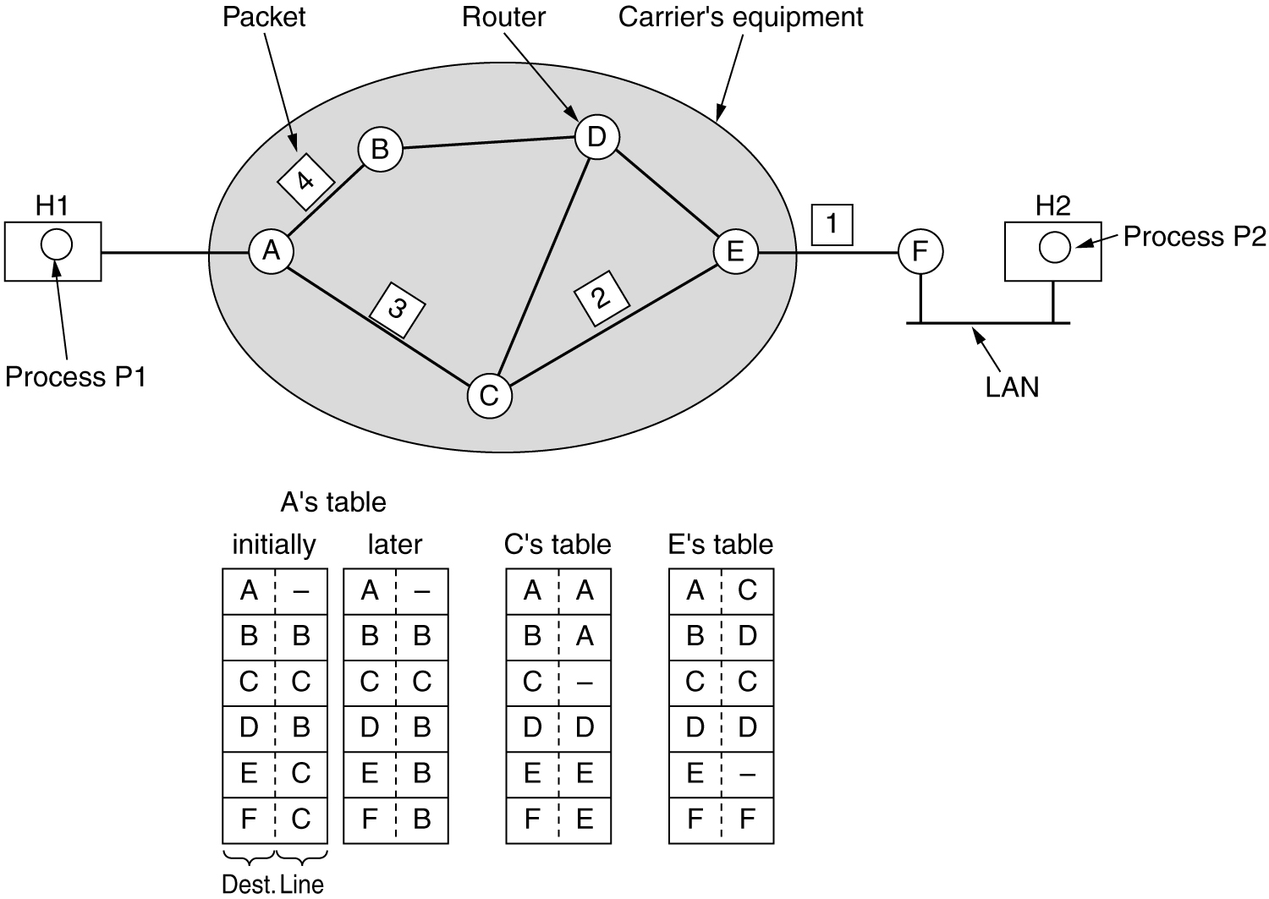
Implementation of Connectionless Service
Routing within a diagram subnet

Slide 22
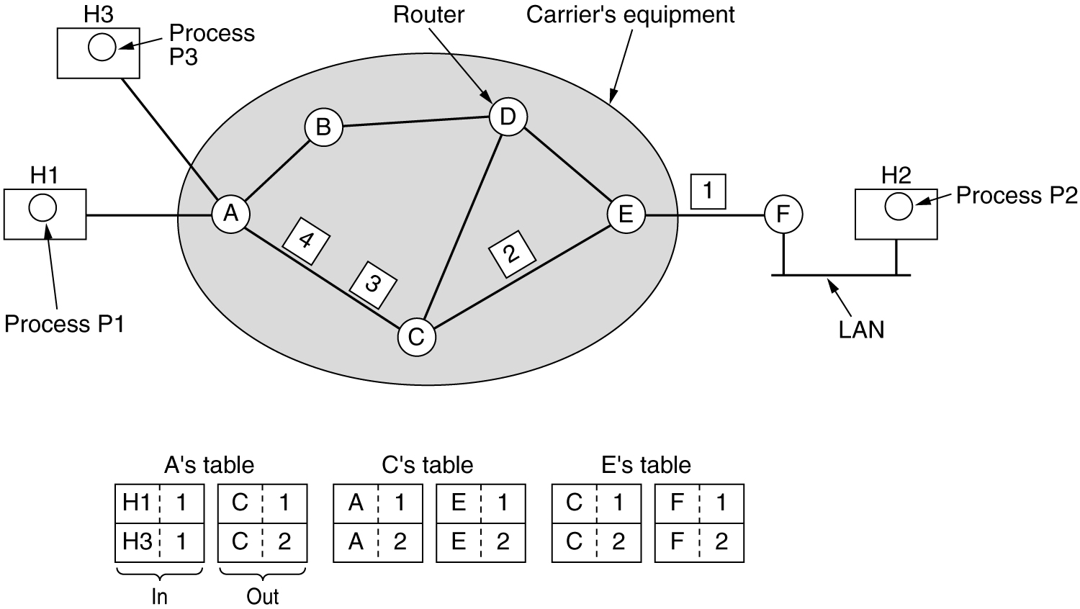
Implementation of Connection-Oriented Service
Routing within a virtual-circuit subnet
Note: 1,2 in table indicates port number/VCI (Virtual Circuit Identifier).

Slide 23
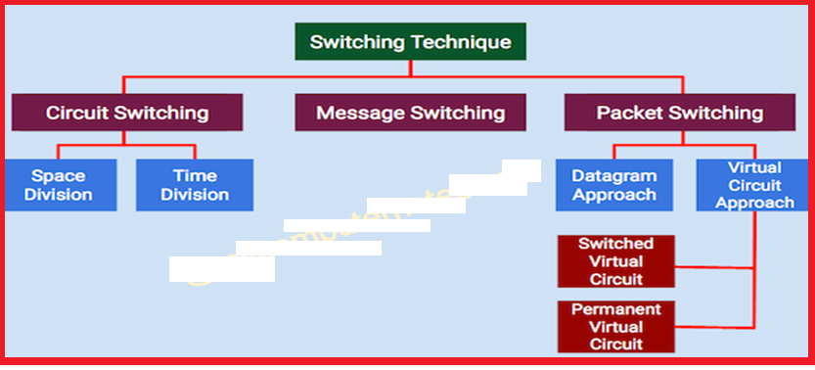
Switching Techniques

Slide 24
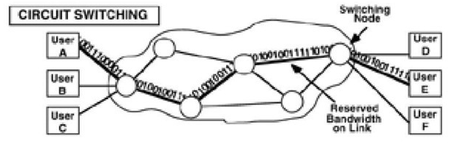
Circuit Switching Techniques
Ex. Telephone Line

Slide 25
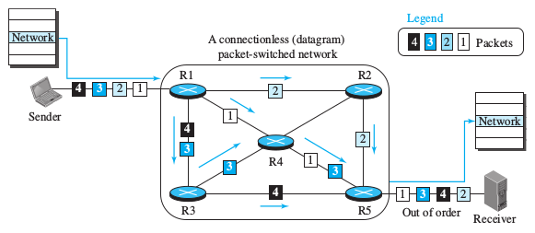
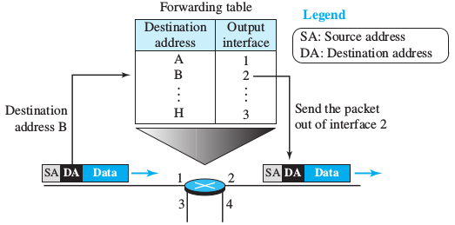
Switching Techniques: Datagram Approach
Figure: A connectionless packet-switched network.
Figure: Forwarding process in a router when used in a connectionless network.

Slide 26
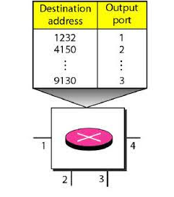
Routing Table in Datagram Network

Slide 27
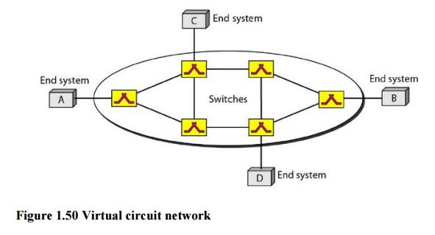
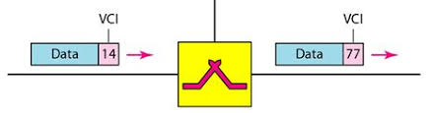
Virtual Circuit Switching
Virtual Circuit Identifiers

Slide 28
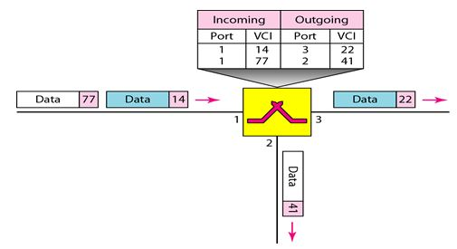
Virtual Circuit Identifiers (VCI)

Slide 29
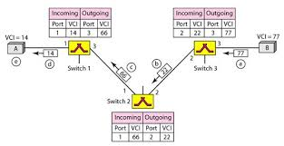
Virtual Circuit Switching - Set up acknowledgement
Set up phase
Set up acknowledgement

Slide 30
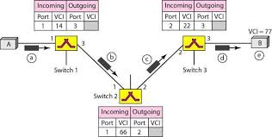
Virtual Circuit Switching - Set up phase
Set up acknowledgement

Slide 31
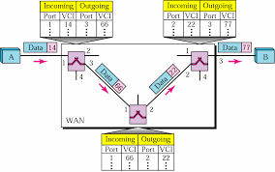
Virtual Circuit Switching - Data Transfer Phase
Switch and Tables in VC Network

Slide 32
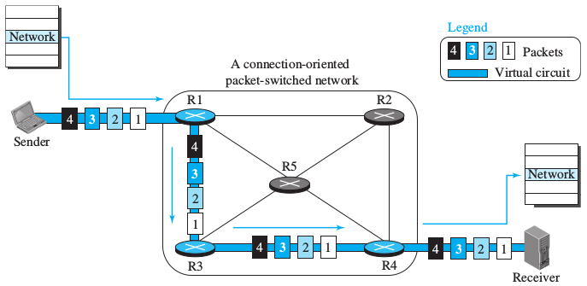
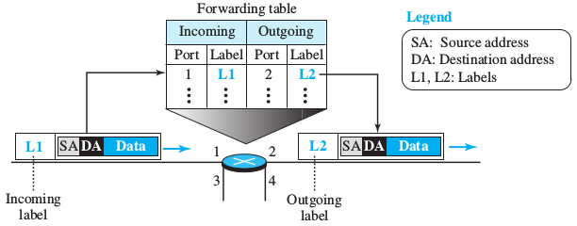
Switching Techniques: Virtual-Circuit Approach
Figure: A virtual-circuit packet-switched network.
Figure: Forwarding process in a router when used in a virtual-circuit network.

Slide 33
Switching Techniques: Datagram and Virtual-Circuit Approach
Figure: A connectionless packet-switched network.
Figure: A virtual-circuit packet-switched network.

Slide 34
Switcing Techniqnics
Packet Switching:
Datagram Approach: Connectionless Service
Virtual-Circuit Approach: Connection-Oriented Service

Slide 35
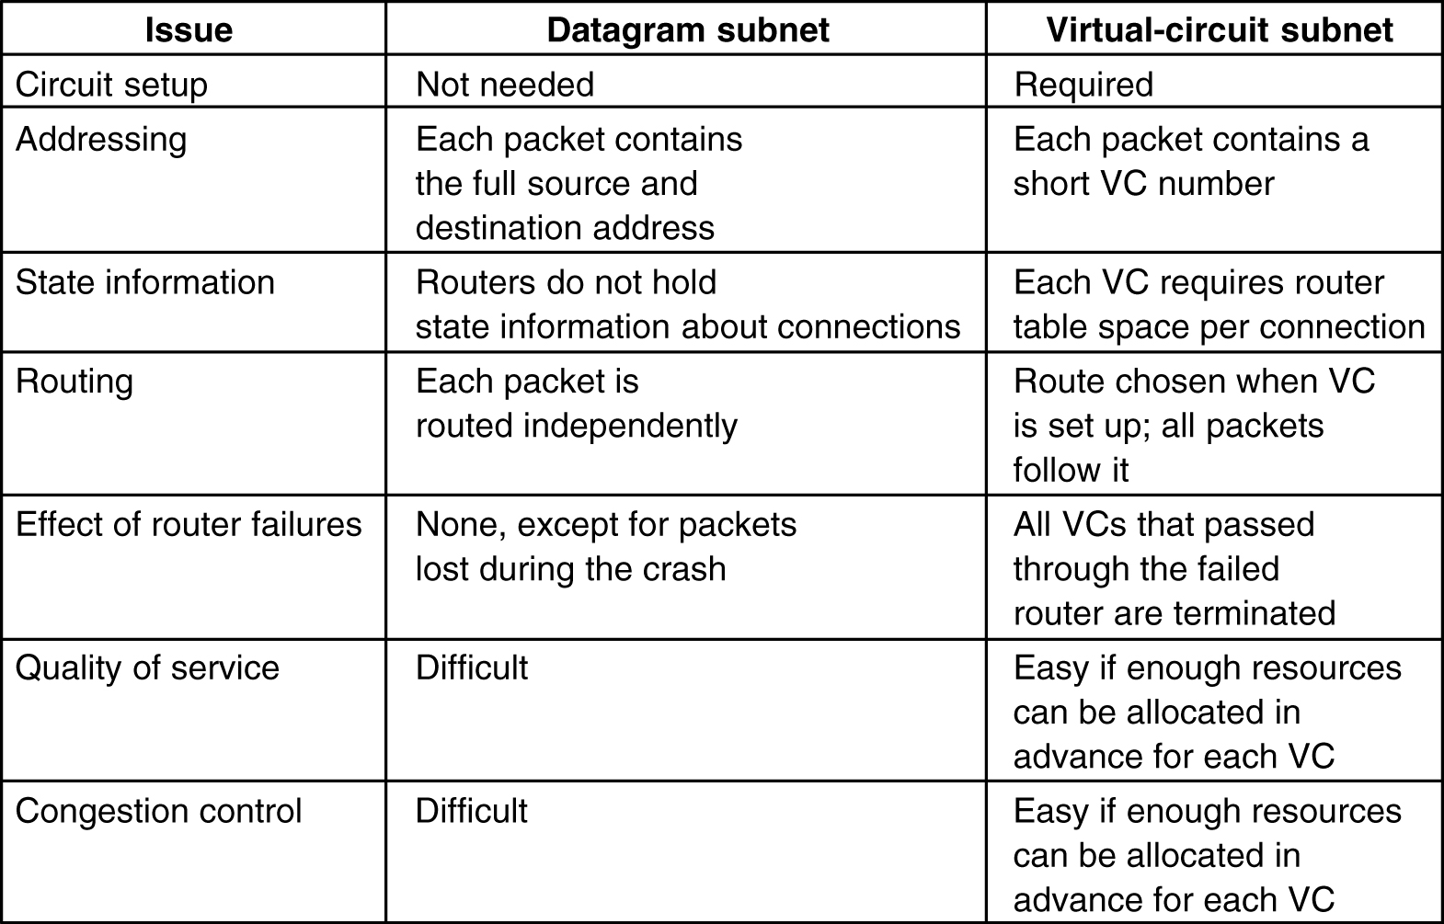
Comparison of Virtual-Circuit and Datagram Subnets

Slide 36
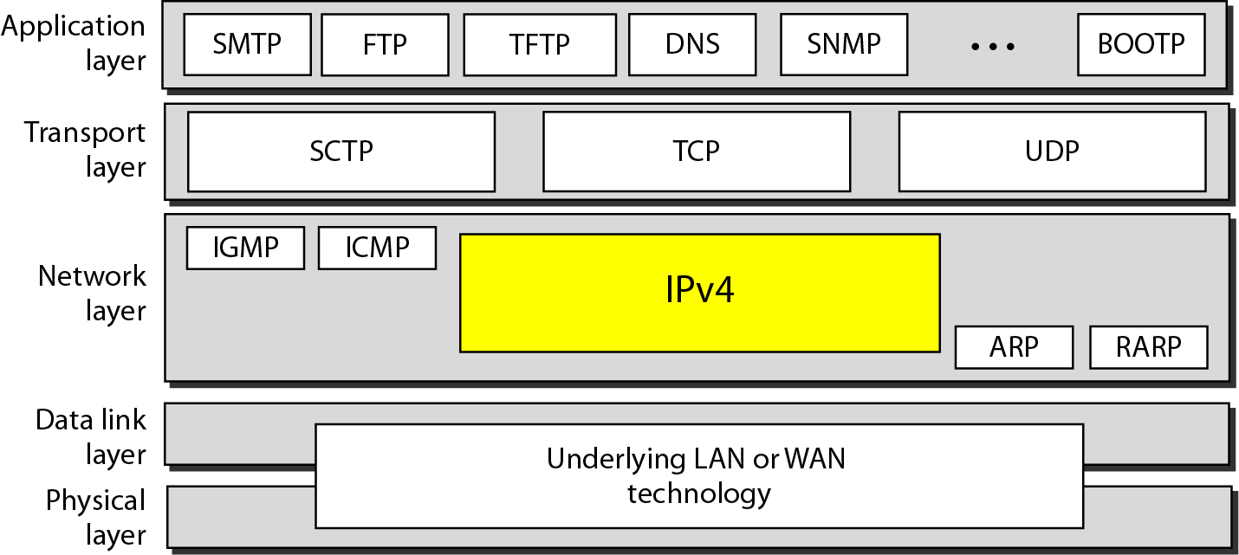
Internet Protocol: IPv4

Slide 37
Network Layer: Logical Addressing
These are 32 bits in size.
Logical address is called as IP address.
These are global addresses.
The Internet addresses are 32 bits in length, called as IPv4 (IP version 4) or IP address
2^32 addresses can be generated (4,29,49,67,296).
IPv6 (IP version 6) as futuristic/new generation addresses 128 bits in size (2^128=7460743177e^38).
2^128 addresses can be generated which can accommodate future need and can address the issue of depletion of IP addresses.

Slide 38
IPv4 Addresses
These are unique and Universal addresses
Each address defines one and only one connection to the internet.
Two devices can never have same IP address at the same time.
An address can be assigned to a device for some time, then taken away and can be assigned to some other device.

Slide 39
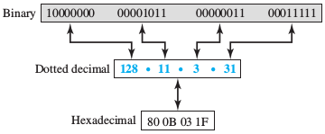
IPv4 Addresses
Address space is 2^32 i.e. 4,294,967,296
Notations:
Decimal dotted notations: 128.11.3.31
Binary notation:

Slide 40
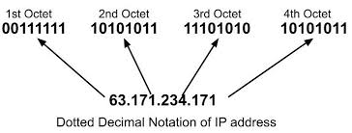
Binary and dotted decimal notations

Slide 41
IPv4 Addresses
Classful addressing.
Right from inception, used the concept of classes.
This architecture is called as classful addressing
The address space is divided in classes A,B,C,D,E
This is becoming obsolete, but necessary to know to understand the rational behind classless addressing.
Classless addressing.

Slide 42
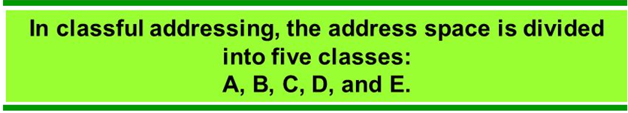
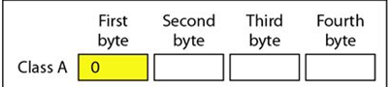
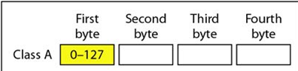
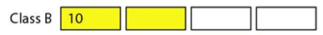
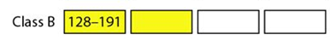
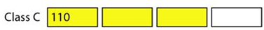
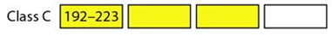
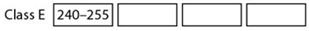
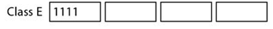
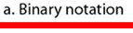
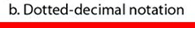

Slide 43
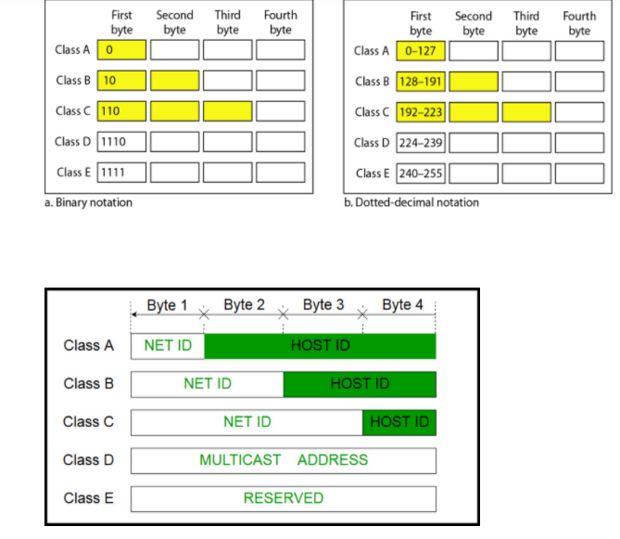
Host ID and Net ID (Does not apply for class D and E)

Slide 44
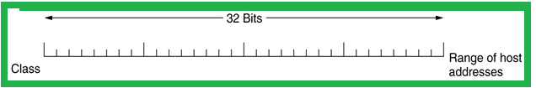
Classful and Special Addressing
Before 1993, IP addresses were divided into the five categories
128 networks with 16 million hosts
16,384 networks with up to 65,536 hosts
2 million networks and 256 hosts

Slide 45
Special IP Addresses

Slide 46
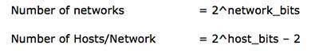
Internet Protocol: IPv4 - Address Space (Cntd.)
The number of networks and the number of hosts per class can be derived by this formula:
When calculating hosts' IP addresses, 2 IP addresses are decreased because they cannot be assigned to hosts.
The first IP of a network is Network number
The last IP is reserved for Broadcast IP.

Slide 47
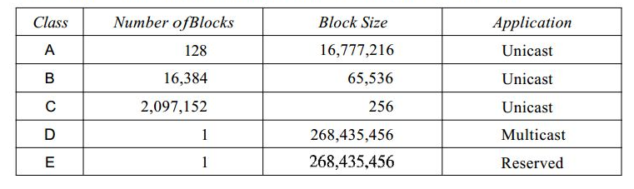
Classes and Blocks

Slide 48
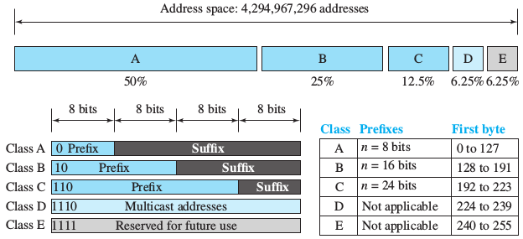
Internet Protocol: IPv4 - Classful Addressing
Figure: Occupation of the address space in classful addressing.

Slide 49
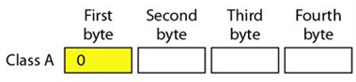
Internet Protocol: IPv4 - Classful Addressing
“Class A” Address:
The first bit of the first octet is always set to 0 (zero). Thus the first octet ranges from 1–127.
Class A addresses only include IP starting from 1.x.x.x to 126.x.x.x only. The IP range 127.x.x.x is reserved for loopback IP addresses.
The default subnet mask for Class A IP address is 255.0.0.0 which implies that Class A addressing can have 126 (2⁷-2) networks and 16777214 (2²⁴-2) hosts .
Class A IP address format is thus:
0NNNNNNN.HHHHHHHH.HHHHHHHH.HHHHHHHH

Slide 50
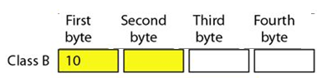
Internet Protocol: IPv4 - Classful Addressing (Cntd.)
“Class B” Address:
An IP address which belongs to class B has the first two bits in the first octet set to 10.
IP Addresses range from 128.0.x.x to 191.255.x.x. The default subnet mask for Class B is 255.255.x.x.
Class B has 16384 (2¹⁴) Network addresses and 65534 (2¹⁶-2) Host addresses.
Class B IP address format is thus:
10NNNNNN.NNNNNNNN.HHHHHHHH.HHHHHHHH

Slide 51
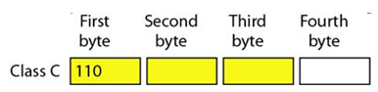
Internet Protocol: IPv4 - Classful Addressing (Cntd.)
“Class C” Address:
The first octet of Class C IP address has its first 3 bits set to 110.
Class C IP addresses range from 192.0.0.x to 223.255.255.x. The default subnet mask for Class C is 255.255.255.x.
Class C gives 2097152 (2²¹) Network addresses and 254 (2⁸-2) Host addresses.
Class C IP address format is thus:
110NNNNN.NNNNNNNN.NNNNNNNN.HHHHHHHH

Slide 52
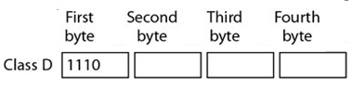
Internet Protocol: IPv4 - Classful Addressing (Cntd.)
“Class D” Address:
Very first four bits of the first octet in Class D IP addresses are set to 1110. Giving range of 11100000-11101111 (224-239)
Class D has IP address rage from 224.0.0.0 to 239.255.255.255.
Class D is reserved for Multicasting.
In multicasting, data is not destined for a particular host, that is why there is no need to extract host address from the IP address.
Class D does not have any subnet mask.

Slide 53
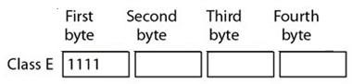
Internet Protocol: IPv4 - Classful Addressing (Cntd.)
5. “Class E” Address:
This IP Class is reserved for experimental purposes only for R&D or Study.
11110000-11111111
240-255
IP addresses in this class ranges from 240.0.0.0 to 255.255.255.254.
Like Class D, this class too is not equipped with any subnet mask.

Slide 54
Example 1
Given the network address 17.0.0.0, find the class, the block, and the range of the addresses.
Solution
The class is A because the first byte is between 0 and 127.
The block has a netid of 17.
The addresses range from 17.0.0.0 to 17.255.255.255.

Slide 55
Example 2
Given the network address 132.21.0.0, find the class, the block, and the range of the addresses.
Solution
The class is B because the first byte is between 128 and 191.
The block has a netid of 132.21
The addresses range from 132.21.0.0 to 132.21.255.255.

Slide 56
Example 3
Given the network address 220.34.76.0,find the class, the block and the range of the addresses.
Solution
The class is C because the first byte is between 192 and 223.
The block has a netid of 220.34.76. 0
The addresses range from 220.34.76.0 to 220.34.76.255.

Slide 57
What is the purpose of an IP Address?
A unique identifier for a computer
A unique location identifier
A network location identifier
None of the above
The IP address 150.255.255.254 is?
The IP address 126.12.3.5 is :
The IP address 223.120.50.1 is :
There are ______ bits in an octet?
5,6,7,8
The default subnet mask for the class A IP address is
What is the name of the type of notation an IP address is usually written?
The default subnet mask for the class B IP address is
Given the IP address 152.16.168.196/28, is the IP address 162.16.168.30 in the same network.
The default subnet mask for the class C IP address is
The full form of IP in IP Address is ______.
An IP address is divided into what two parts:
Physical and logical
Network and subnet
Network and host
Physical and emotional
Convert 1000 0001 to decimal.

Slide 58
Which class has the largest number of hosts ?
IPv4 addresses are ___ bits binary numbers.
Convert 00000100 to decimal.

Slide 59
Sample Examples
Question 1: Given the network address 17.0.0.0, find the class, the block, and the range of the addresses.
Solution:
The class is A because the first byte is between 0 and 127.
The block has a netid of 17.
The addresses range from 17.0.0.0 to 17.255.255.255.

Slide 60
Sample Examples
Question 2: Given the network address 132.21.0.0, find the class, the block, and the range of the addresses.
Solution:
The class is B because the first byte is between 128 and 191.
The block has a netid of 132.21
The addresses range from 132.21.0.0 to 132.21.255.255.

Slide 61
Sample Examples
Question 3: Given the network address 220.34.76.0,find the class,the block,and the range of the addresses.
Solution:
The class is C because the first byte is between 192 and 223.
The block has a netid of 220.34.76.
The addresses range from 220.34.76.0 to 220.34.76.255.

Slide 62
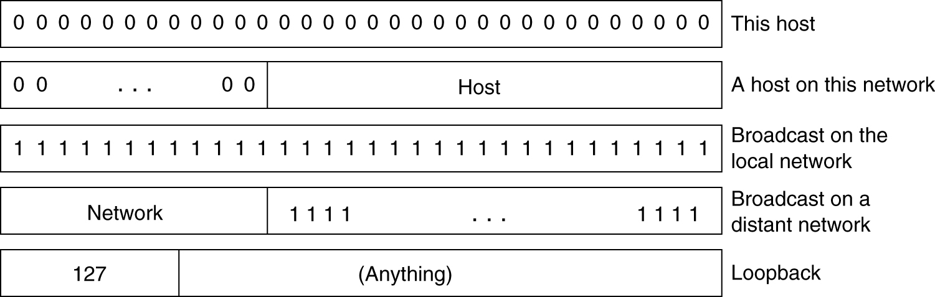
Special IP Addresses

Slide 63
Example 1: An IP packet has arrived with the first 8 bits as shown:
01000010 The receiver discards the packet. Why?
Solution There is an error in this packet. The 4 left-most bits (0100) show the version, which is correct.
The next 4 bits (0010) show the header length; which means (2 × 4 = 8), which is wrong. The minimum number of bytes in the header must be 20. The packet has been corrupted in transmission.
Example 2: In an IP packet, the value of HLEN is 1000 in binary. How many bytes of options are being carried by this packet?
Solution The HLEN value is 8, which means the total number of bytes in the header is 8 × 4 or 32 bytes. The first 20 bytes are the base header, the next 12 bytes are the options.

Slide 64
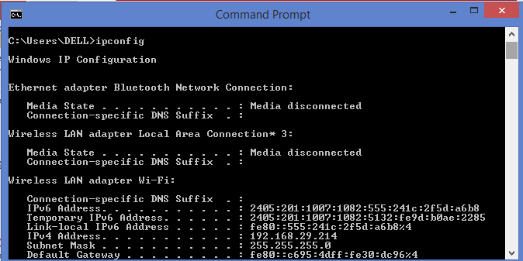

Slide 65
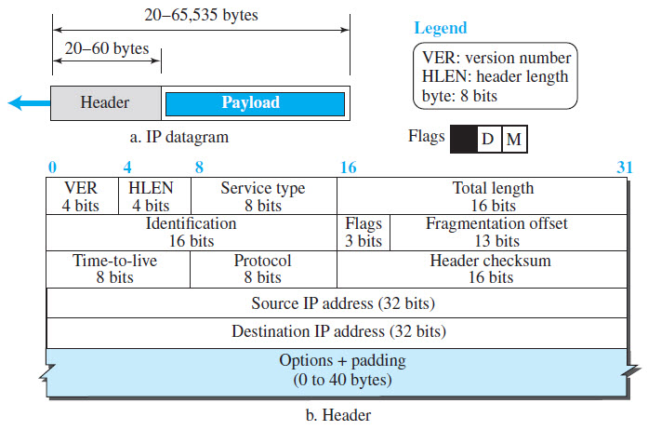
IPv4: Header 439 PP
D-Do not Fragment
M-More Fragment

Slide 66
IPv4
Connectionless Protocol i.e. Datagram service
Header size Minimum length =20 bytes and Max=60 bytes
Payload = Data (received from Transport Layer) = 0 to 65515 bytes
So Datagram size= Header+ Payload =2^16 = (65,536)

Slide 67
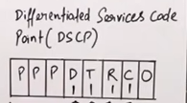
Internet Protocol: IPv4
Version=4 bits=0100 means IPv4
Header length=4 Bit
Service type=8 bits=
P-Priority (packet)
D-Delay - Ex. VoIP (WhatsApp calling)
(D=0 delay not an issue)
T-Throughput (T=1 means Rate of Transfer is more)
R-Reliability (Without dropping packet)
C-Congestion Control-Cost-Follow shortest path
0-Zero-Reserve for future purpose
Total length=16 Bits =65535=Datagram
TTL-Time to Live-2^8=255-Single packet move across 255 nodes and then drop Once packet value is zero.
Protocol- Facility of Transport layer protocol is used in network layer i.e. TCP,UDP,ICMP (used in this field)

Slide 68
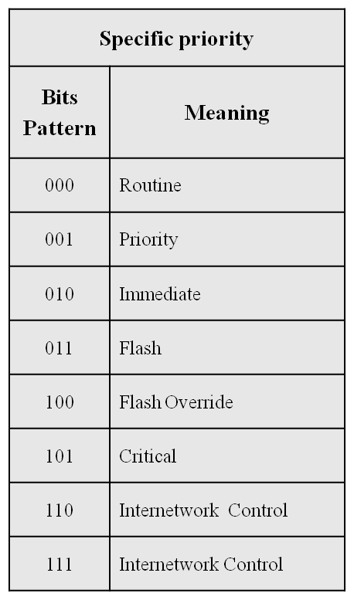
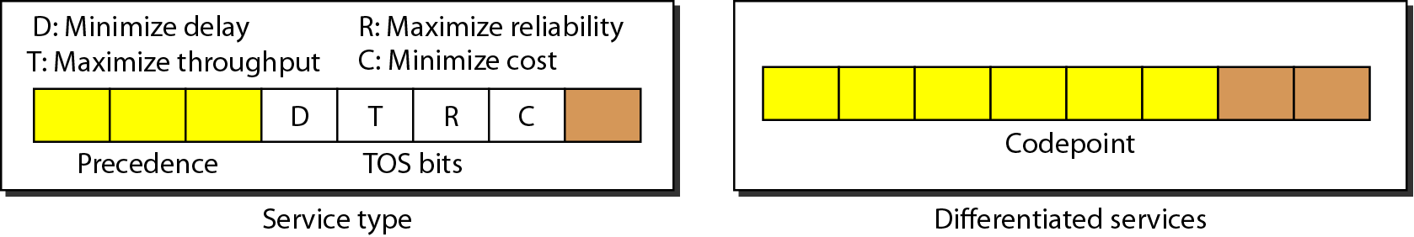
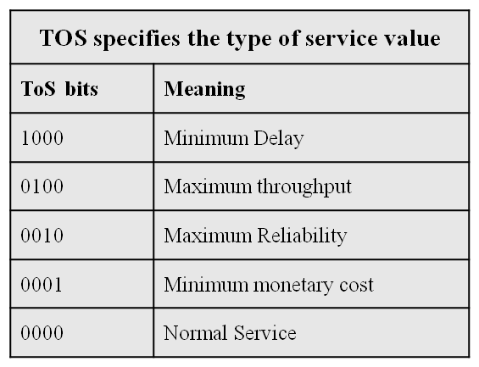
Type of Service (ToS)
P
P
P
PPP

Slide 69


IPv4 Header Format
IP is an unreliable and connectionless best-effort delivery service protocol.

Slide 70

Fragmentation and Re-assembly
IP Fragmentation is a process of dividing the datagram into fragments during its transmission.
It is done by intermediary devices such as router.
Need:
Each network has its maximum transmission unit (MTU). Ethernet- 1500 bytes
It dictates the maximum size of the packet that can be transmitted through it.
Data packets of size greater than MTU can not be transmitted through the network. So, datagrams are divided into fragments of size less than or equal to MTU
1) Size of the datagram is found to be smaller than or equal to MTU, Router transmits the datagram without any fragmentation.
2) Size of the datagram is found to be greater than MTU and DF bit set to 1. In this case, router discards the datagram.
3) Size of the datagram is found to be greater than MTU and DF bit set to 0.
- Router divides the datagram into fragments of size less than or equal to MTU.
- Router attaches an IP header with each fragment with necessary changes.
- transmits all the fragments of the datagram.
maximum transmission unit

Slide 71

Example 3: Fragmentation example
Fragmentation offset This 13-bit field shows the relative position of this fragment with respect to the whole datagram. It is the offset of the data in the original datagram measured in units of 8 bytes. Figure shows a datagram with a data size of 4000 bytes fragmented into three fragments. The bytes in the original datagram are numbered 0 to 3999. The first fragment carries bytes 0 to 1399. The offset for this datagram is 0/8 = 0. The second fragment carries bytes 1400 to 2799; the offset value for this fragment is 1400/8 = 175. Finally, the third fragment carries bytes 2800 to 3999. The offset value for this fragment is 2800/8 = 350. Value of the offset is measured in units of 8 bytes.

Slide 72


Example 3: Fragmentation example

Slide 73
Fragmentation Problems
4. A packet has arrived with an M bit of 0. Is this the first fragment, the last fragment, or a middle fragment? Do we know if the packet was fragmented?
Solution: If the M bit is 0, it means that there are no more fragmentations; the fragment is the last one.
However we cannot say if the original packet was fragmented or not.
A non-fragmented packet is considered the last fragment.
5. A packet has arrived with an M bit of 1. Is this the first fragment, the last fragment, or a middle fragment? Do we know if the packet was fragmented?
Solution: If M bit is 1, it means that there is at least one more fragment. This fragment can be the first one or the middle one, but not the last one.
More information is needed to say whether it is the first or middle one but we can say that the original packet was fragmented because the M bit vale is 1.

Slide 74
Fragmentation Problems
6. A packet has arrived with an M bit of 1 and a fragmentation offset value of zero. Is this the first fragment, the last fragment, or a middle fragment?
Solution: As the M bit is 1, it is either a first or a middle fragment. Since the offset is 0, it is supposed to be first fragment.
7. A packet has arrived in which the offset value is 100, the value of HLEN is 5, and
the value of the total length field is 100. What are the numbers of the first byte and
the last byte?
Solution:
The first byte number is 100 × 8 = 800. The total length is 100 bytes, and the header length is 20 bytes (5 × 4), which means that there are 80 bytes in this datagram. If the first byte number is 800, the last byte number must be 879.

Slide 75


A mask is a 32-bit binary number that gives the first address in the block
(the network address) when bitwise ANDed with an address in the block.
And Operation

Slide 76

Default Masks used
-Default Masks used

Slide 77




Network address
The first address in a block is normally not assigned to any device.
It is used as the network address that represents the organization to the rest of the world.

Slide 78


Slide 79

Subnets: Classless Inter Domain Routing [CIDR]
Figure: Slash notation / Classless Inter Domain Routing (CIDR).

Slide 80
Classless Addressing
Classless Addressing is an improved IP Addressing system.
It makes the allocation of IP Addresses more efficient.
It replaces the older classful addressing system based on classes.
It is also known as Classless Inter Domain Routing (CIDR).
Why Classless?.
To overcome address depletion
Give access of Internet to more organizations
There are no classes but addresses are still granted in blocks

Slide 81
Classless Addressing
Efficient address-space allocation is available in classless addressing.
Memory is allocated in terms of bits and bytes rather than huge chunks of contiguous memory.
It eliminates any class imbalances.

Slide 82
Example 11
A block of addresses is granted to a small organization. We know that one of the addresses is 205.16.37.39/28. What is the first address in the block? (Prefix length is 28)
Solution:
The binary representation of the given address is
11001101 00010000 00100101 00100111
Mask is 11111111 11111111 11111111 11110000
If we set 32−28 rightmost bits to 0, we get first address in the block
11001101 00010000 00100101 00100000
or 205.16.37.32

Slide 83

Classless Addressing
Restrictions
Addresses in a block must be contiguous.
No. of addresses in a block must be a power of 2 (1,2,4,8,….)
The first address must be evenly divisible by the no. of addresses.

Slide 84
Classless Addressing
Restrictions
Addresses in a block must be contiguous
No. of addresses in a block must be a power of 2 (1,2,4,8,….)
The first address must be evenly divisible by the no. of addresses.

Slide 85
Classless Addressing
Network Address and Mask:
Network address:
It identifies a network on internet.
Using this, we can find range of addresses in the network and total possible number of hosts in the network.
Mask:
It is a 32-bit binary number that gives the network address in the address block when bitwise AND operation is applied on the mask and any IP address of the block.

Slide 86
Classless Addressing
Network Address and Mask
In IPv4 addressing, a block of addresses can be defined as
x.y.z.t /n Ex. 192.168.1.1/28
In which x.y.z.t defines one of the addresses and /n defines the mask

Slide 87
Classless Addressing
Subnetting:
Dividing a large block of addresses into several contiguous sub-blocks and assigning these sub-blocks to different smaller networks is called subnetting.
It is a practice that is widely used when classless addressing is done.

Slide 88


Subnets: Default Mask vs Subnet Mask
192 = 11000000
72 = 01001000
Bitwise AND = 01000000 = 64
Figure: Calculation of Network Addresses with Default Mask and Subnet Mask.

Slide 89
Classless Addressing – Subnetting
To reduce the wastage of IP addresses in a block, we use sub-netting.
Some of the Host id bits are used as net id bits of a classful IP address.
We give the IP address and define the number of bits for mask along with it (usually followed by a ‘/’ symbol), like, 192.168.1.1/28.
Subnet mask is found by putting the given number of bits out of 32 as 1
Ex: In the given address, we need to put 28 out of 32 bits as 1 and the rest as 0, and so, the subnet mask would be 255.255.255.240.
11111111.11111111.11111111. 11110000

Slide 90
Classless Addressing
Some values calculated in subnetting :
1. Number of subnets : Given bits for mask – No. of bits in default mask
2. Subnet address : AND result of subnet mask and the given IP address
3. Broadcast address : By putting the host bits as 1 and retaining the network bits as in the IP address
4. Number of hosts per subnet : 2^{(32 – Given bits for mask)} – 2
5. First Host ID : Subnet address + 1 (adding one to the binary representation of the subnet address)
6. Last Host ID : Subnet address + Number of Hosts

Slide 91
Classless Addressing (1st Method)
Some values calculated in subnetting :
The first address in the block can be found out by setting the rightmost 32-n bits to 0s
The last address in the block can be found out by setting the rightmost 32-n bits to 1s
Ex: A block of addresses is granted to a small organization. One of the address is 205.16.37.39/28. What is first and last address?
Solution:
Binary representation of given address: 11001101 00010000 00100101 00100111
Binary representation of mask: 11111111 11111111 11111111 11110000
First address : 11001101 00010000 00100101 00100000 = 205.16.37.32
Last address : 11001101 00010000 00100101 00101111 = 205.16.37.47
No. of addresses = 2^(32 -28) = 2^4 = 16

Slide 92
Classless Addressing (2nd Method)
Ex: A block of addresses is granted to a small organization. One of the address is 205.16.37.39/28. What is first and last address?
Binary representation of given address: 11001101 00010000 00100101 00100111
Binary representation of mask: 11111111 11111111 11111111 11110000
First address : Bitwise AND operation of given address and mask = 205.16.37.32
Last address : Take compliment of the mask and do bitwise OR operation
Given address: 11001101 00010000 00100101 00100111
Compliment of the mask: 000000000 00000000 00000000 00001111 = 205.16.37.47
No. of addresses :
Compliment of the mask + 1 = 000000000 00000000 00000000 00001111 + 1 = 16

Slide 93
Example 12
What is the Network Address if one of the addresses is 167.199.170.82/27?
Solution:
The prefix length is 27,which means that we must keep the first 27bits as 1s and change the remaining bits (5) to 0s.The 5 bits affect only the last byte.
The last byte is 01010010 (82).Changing the last 5 bits to 0s,we get 01000000 or 64.
The network address is 167.199.170.64/27.

Slide 94

Subnets
Figure: LAN: Campus network for various departments.

Slide 95




Slide 96
Classless Addressing – Subnetting
Problem:
An Organization is given a block 17.12.14.0/26. which contains 64 addresses.
The organization has 3 offices and needs to divide the addresses into 3 subblocks of 32, 16 and 16.
How the subnetting will be performed?.

Slide 97
Classless Addressing – Subnetting
17.12.14.0/26. 64 addresses.
3 offices and needs to divide the addresses into 3 subblocks of 32, 16 and 16.
How the subnetting will be performed?.

Slide 98





Classless Addressing – Solution 17.12.14.0/26
16 addresses
32 addresses
16 addresses

Slide 99

Classless Addressing – Solution 17.12.14.0/26
16 addresses
32 addresses
16 addresses

Slide 100
Classless Addressing – Solution – How?
We need to decide the mask for subnetting
Suppose the mask for Subnet 1 is n1 then 2^(32-n1) = 32 means n1 = 27
Suppose the mask for Subnet 2 is n2 then 2^(32-n2) = 16 means n1 = 28
Suppose the mask for Subnet 3 is n3 then 2^(32-n3) = 16 means n1 = 28
So We must have masks 27, 28 and 28 with the organization mask being 26.

Slide 101
Classless Addressing – Solution – How?
Calculation of First and Last addresses for each Subnet from one of the addresses in the subnet
Subnet 1 17.12.14.29 /27
Given Addresses: 17.12.14.29 = 00010001 00001100 00001110 00011101
Mask is /27 = 11111111 11111111 11111111 11100000
First Address: 00010001 00001100 00001110 00000000 = 17.12.14.0
Last Address: 00010001 00001100 00001110 00011111 = 17.12.14.31

Slide 102
Classless Addressing – Solution – How?
Calculation of First and Last addresses for each Subnet from one of the addresses in the subnet
Subnet 2 17.12.14.45 /28
Given Addresses: 17.12.14.0 = 00010001 00001100 00001110 00101101
Mask is /28 = 11111111 11111111 11111111 11110000
First Address: 00010001 00001100 00001110 00100000 = 17.12.14.32
Last Address: 00010001 00001100 00001110 00101111 = 17.12.14.47

Slide 103
Example 13
A small organization is given a block with the beginning address and the prefix length 205.16.37.24/29 (in slash notation).
What is the range of the block?
Solution:
The beginning address is 205.16.37.24.To find the last address we keep the first 29 bits and change the last 3 bits to1s.
Beginning:11001111 00010000 00100101 00011000
Ending : 11001111 00010000 00100101 00011111
There are only 8 addresses in this block.

Slide 104
Classless Addressing – Solution – How?
Calculation of First and Last addresses for each Subnet from one of the addresses in the subnet
Subnet 3 17.12.14.50 /28
Given Addresses: 17.12.14.0 = 00010001 00001100 00001110 00110010
Mask is /28 = 11111111 11111111 11111111 11110000
First Address: 00010001 00001100 00001110 00110000 = 17.12.14.48
Last Address: 00010001 00001100 00001110 00111111 = 17.12.14.63

Slide 105

Classless Addressing – Ex: An organization that is granted block of 16 addresses

Slide 106


Levels of Hierarchy
Two Level Hierarchy – No Subnetting Three Level Hierarchy – Subnetting
The structure of classless addressing does not restrict no. of hierarchical levels

Slide 107
The number of networks and the number of hosts per class can be derived by this formula:
When calculating hosts' IP addresses, 2 IP addresses are decreased because they cannot be assigned to hosts, i.e. the first IP of a network is network number and the last IP is reserved for Broadcast IP.

Slide 108

Subnets: Classless Inter Domain Routing [CIDR] (Cntd.)
Figure: Prefix lengths.

Slide 109

Subnets cont..
Class B network: 64 subnets

Slide 110
Subnets cont..
Example : What is the maximum number of hosts it can handle if a subnet mask is 255.255.240.0?
Example : A company is granted a site address 201.70.64.0. The company needs six subnets. Design the subnets.
Example : For a given class- C network 195.188.65.0 design the equal subnets in such a way that each subnet has at least 60 nodes.
Example : Suppose that instead of using 16- bits for the class B address originally, 20 bits had been used. How many class B networks addresses would there have been.
Example : For a given class B network 144.155.0.0 with default subnet mask. How can you divide it into 8 equal subnets. How many hosts can be accommodated in each subnets.

Slide 111
Example 14
A company is granted the site address 201.70.64.0 (class C). The company needs six subnets. Design the subnets.
Solution:
The number of 1s in the default mask is 24 (class C).
The company needs six subnets. This number 6 is not a power of 2.
The next number that is a power of 2 is 8 i.e (2^3).
We need 3 more 1s in the subnet mask.
The total number of 1s in the subnet mask is 27(24+3).
The total number of 0s is 5=(32-27).
The mask is 11111111 11111111 11111111 11100000 or 255.255.255.224
The number of subnets is 8.
The number of addresses in each subnet is 2^5 (5is the number of 0s) or 32.

Slide 112


Slide 113
Variable length subnet mask (VLSM)
When we perform subnetting, all subnets have the same number of hosts, this is known as FLSM (Fixed length subnet mask).
In FLSM, all subnets use same subnet mask. Hence, the subnet wastages IP addresses space.
VLSM is a process of dividing an IP network into the subnets of different sizes without wasting IP addresses.

Slide 114

Classless Inter Domain Routing(CIDR)
Classful addresses are IP addresses that use the default subnet mask.
CIDR allows for variable length subnet masking
The network mask is the number of left-most contiguous mask bits that are set to one.
CIDR address 194.24.0.0 /21
IP address assignments
2 to power 11 = 2048
2 to power 10 = 1024
2 to power 10 = 1024
2 to power 12 = 1024

Slide 115
First and Last Address
In IPv4 addressing, a block of addresses can be defined as x.y.z.t /n
in which x.y.z.t defines one of the addresses and the /n defines the mask.
The first address in the block can be found by setting the rightmost 32 − n bits to 0s.
The last address in the block can be found by setting the rightmost 32 − n bits to 1s.
The number of addresses in the block can be found by using the formula 2^{32 − n}

Slide 116

Example 16: An organization is granted the block 130.34.12.64/26. The organization needs to have four subnets with equal number of addresses in each subnet. What are the subnet addresses and the range of addresses for each subnet?
Solution: We need four subnets, which means we need to add two more 1s.
If we create four subnets, each subnet will have 16 addresses ( 2^{32–28} = 16 addresses)
The subnet prefix is then /28.
The range of addresses for each subnet is shown below:
Subnet 1: 130.34.12.64/28 to 130.34.12.79/28.
Subnet 2 : 130.34.12.80/28 to 130.34.12.95/28.
Subnet 3: 130.34.12.96/28 to 130.34.12.111/28.
Subnet 4: 130.34.12.112/28 to 130.34.12.127/28.

Slide 117
Example 17: An ISP is granted a block of addresses starting with 190.100.0.0/16 (65,536 addresses). The ISP needs to distribute these addresses to three groups of customers as follows:
i. The first group has 64 customers; each needs 256 addresses.
ii. The second group has 128 customers; each needs 128 addresses.
iii. The third group has 128 customers; each needs 64 addresses.
Design the subblocks and find out how many addresses are still available after these allocations.

Slide 118

190.100.0.0/16
64 customers; each needs 256 addresses
128 customers; each needs 128 addresses
128 customers; each needs 64 addresses.

Slide 119

Group 1
For this group, each customer needs 256 addresses. This means that 8 (log₂256) bits are needed to define each host. The prefix length is then 32 − 8 = 24. The addresses are

Slide 120

Group 2
For this group, each customer needs 128 addresses. This means that 7 (log₂ 128) bits are needed to define each host. The prefix length is then 32 − 7 = 25. The addresses are

Slide 121

Group 3
For this group, each customer needs 64 addresses. This means that 6 (log₂ 64) bits are needed to each host. The prefix length is then 32 − 6 = 26. The addresses are
Number of granted addresses to the ISP: 65,536
Number of allocated addresses by the ISP:
16384 + 16384 +8192 = 40,960
Number of available addresses: 65,536 - 40,960 = 24,576

Slide 122

Question:

Slide 123
Example :
Given IP Address – 172.16.0.0/25, find the number of subnets and the number of hosts per subnet. Also, for the first subnet block, find the subnet address, first host ID, last host ID and broadcast address.
Solution :
This is a class B address. So, no. of subnets = 2⁽²⁵⁻¹⁶⁾ = 2⁹ = 512.
No. of hosts per subnet = 2⁽³²⁻²⁵⁾ – 2 = 2⁷ – 2 = 128 – 2 = 126
For the first subnet block, we have subnet address = 0.0,
first host id = 0.1
last host id = 0.126
broadcast address = 0.127

Slide 124
Practice Example: 255.255.255.224 (/27) Network 192.168.10.0
How many subnets? 224 is 11100000, so our equation would be 2³ = 8.
How many hosts? 2⁵– 2 = 30.
What are the valid subnets? 256 – 224 = 32. We just start at zero and count to the subnet mask value in blocks (increments) of 32: 0, 32, 64, 96, 128, 160, 192, and 224.
What’s the broadcast address for each subnet (always the number right before the next subnet)?
What are the valid hosts (the numbers between the subnet number and the broadcast address)?

Slide 125
Practice Example: 255.255.255.224 (/27) Network 192.168.10.0
Subnet Address | 0 | 32 | …………. | 192 | 224
First Host | 1 | 33 |  | 193 | 225
Last Host | 30 | 62 |  | 222 | 254
Broadcast Address | 31 | 63 |  | 223 | 255

Slide 126

Internet Protocol: IPv6

Slide 127
Internet Protocol: IPv6
Initial motivation:
32-bit address space soon to be completely allocated
Additional motivation:
header format helps speed processing/forwarding
header changes to facilitate QoS
IPv6 datagram format:
Fixed length 40-byte header
fragmentation not allowed

Slide 128


Internet Protocol: IPv6 Addresses

Slide 129


IPv6: Packet Format (Datagram)
Fixed length 40-byte header
https://www.youtube.com/watch?v=U3rGOTxwXAI
Priority (Traffic Class): identify priority among datagrams. Congestion control.
Flow Label: Used in real time data processing. identify datagrams in same ‘flow’ i.e. convert datagram into virtual circuit (decide flow direction in advance).
Next Header: identify upper layer protocol for data.
Hop Limit= TTL
P-Priority (packet)
D-Delay - Ex. VoIP (WhatsApp calling)
(D=0 delay not an issue)
T-Throughput (T=1 means Rate of Transfer is more)
R-Reliability (Without dropping packet)
C-Congestion Control-Cost-Follow shortest path
0-Zero-Reserve for future purpose
4 bytes
4 bytes
16 bytes
16 bytes

Slide 130


Internet Protocol: IPv6 Extension Headers
Figure: IPv6 Extension Headers and Hierarchy.

Slide 131



Internet Protocol: IPv6 Extension Headers (Cntd.)
The structure of the Jumbo Payload option.
Figure: The hop-by-hop extension header for large datagrams (jumbograms).
It is used to indicate a payload size that is greater than 65,535 bytes.
https://www.microsoftpressstore.com/articles/article.aspx?p=2225063&seqNum=4

Slide 132
Internet Protocol: IPv6 Extension Headers (Cntd.)
Figure: The extension header for routing.

Slide 133

Internet Protocol: IPv6 Header
Figure: IPv6 fixed header format.

Slide 134
Advantages of IPv6
Larger address space
Better header format
New options
Allow for extension
Support for resource allocation
Support for more security

Slide 135
Internet Protocol: IPv6 Goals
Support billions of hosts
Reduce routing table size
Simplify protocol
Better security
Attention to type of service
Multicasting (A multicast address enables a device to send a datagram to a specified set of hosts, known as a multicast group, in different subnetworks)
Roaming host without changing address
Allow future protocol evolution
Permit coexistence of old, new protocols. . .

Slide 136
Compare IPv4 and IPv6

Slide 137
Compare IPv4 and IPv6
IPv4 (Internet Protocol Version 4) | IPv6 (Internet Protocol Version 6)
Encryption and authentication is not provided in IPv4 (Internet Protocol Version 4). | Encryption and authentication is provided in IPv6 (Internet Protocol Version 6)
Header of IPv4 is 20 – 60 bytes. | Header of IPv6 is fixed at 40 bytes
Checksumfield is available in IPv4. | Checksumfield is not available in IPv6.
Packet flow identification is not available in IPv4 (Internet Protocol Version 4). | Packet flow identification is available in IPv6. Flow label field is available in the header.
IPv4 addresses are usually represented in dot-decimal notation, consisting of four decimal numbers, each ranging from 0 to 255, separated by dots. | An IPv6 address is represented as eight groups of four hexadecimal digits, each group representing 16 bits.
Sender and forwarding routers performs fragmentation in IPv4 | Fragmentation is performed only by the sender in IPv6.
In IPv4, security features relies on application | In IPv6, there is an inbuilt security feature named IPSEC.
End to end connection integrity cannot be achieved in IPv4. | End to end connection integrity can be done in IPv6.
IPv4 supports DHCP and Manual address configuration | IPv6 supports renumbering and auto address configuration.
IPv4 addresses are 32-bit long | IPv6 addresses are 128 bits long.
The address space in IPv4 is 4.29 ×109 | The address space in IPv6 is 3.4 ×1038
IPv4 has a broadcast message transmission scheme. | Multicast and Anycast message transmission scheme is available in IPv6.

Slide 138
Parameters | Ipv4 | Ipv6
Address length | IPv4 is a 32-bit address. | IPv6 is a 128-bit address.
Fields | IPv4 is a numeric address that consists of 4 fields which are separated by dot (.). | IPv6 is an alphanumeric address that consists of 8 fields, which are separated by colon.
Classes | IPv4 has 5 different classes of IP address that includes Class A, Class B, Class C, Class D, and Class E. | IPv6 does not contain classes of IP addresses.
Number of IP address | IPv4 has a limited number of IP addresses. | IPv6 has a large number of IP addresses.
VLSM | It supports VLSM (Virtual Length Subnet Mask). Here, VLSM means that Ipv4 converts IP addresses into a subnet of different sizes. | It does not support VLSM.
Address configuration | It supports manual and DHCP configuration. | It supports manual, DHCP, auto-configuration, and renumbering.
Address space | It generates 4 billion unique addresses | It generates 340 undecillion unique addresses.
End-to-end connection integrity | In IPv4, end-to-end connection integrity is unachievable. | In the case of IPv6, end-to-end connection integrity is achievable.
Security features | In IPv4, security depends on the application. This IP address is not developed in keeping the security feature in mind. | In IPv6, IPSEC is developed for security purposes.
Address representation | In IPv4, the IP address is represented in decimal. | In IPv6, the representation of the IP address in hexadecimal.
Fragmentation | Fragmentation is done by the senders and the forwarding routers. | Fragmentation is done by the senders only.
Packet flow identification | It does not provide any mechanism for packet flow identification. | It uses flow label field in the header for the packet flow identification.
Checksum field | The checksum field is available in IPv4. | The checksum field is not available in IPv6.
Transmission scheme | IPv4 is broadcasting. | On the other hand, IPv6 is multicasting, which provides efficient network operations.
Encryption and Authentication | It does not provide encryption and authentication. | It provides encryption and authentication.
Number of octets | It consists of 4 octets. | It consists of 8 fields, and each field contains 2 octets. Therefore, the total number of octets in IPv6 is 16.

Slide 139
Contents
Services
Switching Techniques: Datagram Approach, Virtual-Circuit Approach
Internet Protocol: Ipv4 & Ipv6
Classful Addressing
Classless Addressing
CIDR, Subnetting
NAT, ICMP
Routing Algorithms: Distance-Vector (DV) Routing,
Link State (LS) Routing
Routing in Internet: RIP, OSPF, BGP

Slide 140
NAT – Network Address Translation

Slide 141


NAT – Network Address Translation
IANA: Internet Assigned Numbers Authority

Slide 142


Private Addresses Range 49.248.200.4 : Your public IP address

Slide 143

NAT – Address Translation

Slide 144

NAT – Network Address Translation

Slide 145


Slide 146

NAT – Network Address Translation
Figure: Network Address Translation (NAT).

Slide 147
Network Address Translation (NAT)
Each organization gets a single (or small number of) IP addresses.
This is used for Internet traffic only.
For internal traffic, each host gets its own “internal” IP address.
Three IP ranges have been declared as “private”.
No “private” IP address can show up on the Internet, i.e., outside the organization’s network.
Range of addresses | Total number
10.0.0.0 to 10.255.255.255 | 2²⁴
172.16.0.0 to 172.31.255.255 | 2²⁰
192.168.0.0 to 192.168.255.255 | 2¹⁶

Slide 148

NAT does not allow multiple private hosts to use a single public IP address.
Basic NAT works as one-to-one mapping.
Use NAPT ( Network Address Port Translation): many to one address translation

Slide 149

College Public IP Address: 103.96.41.130

Slide 150
Mapping
Mapping a logical address to its corresponding physical address.
Static Mapping:
means creating a table that associates a logical address with a physical address
need to update periodically.
Dynamic Mapping:
each time a machine knows one of the two addresses (logical or physical), it can use a protocol to find the other one.
ARP (address resolution protocol), RARP (reverse address resolution protocol)

Slide 151
ARP ( Address Resolution Protocol) and RARP (Reverse Address Resolution Protocol)
The logical addresses in TCP/IP protocol suite are IP addresses.
Physical address is usually implemented in hardware.
Ex: 48-bit MAC addresses in Ethernet is imprinted on the NIC installed in the host.

Slide 152



ARP (Address Resolution Protocol) Operation

Slide 153


ARP Packet
Hardware Type – Ethernet is type 1
Protocol Type- IPv4=x0800
Hardware Length: length of Ethernet Address (6)
Protocol Length: length of
IPv4 address (4)

Slide 154

Encapsulation of ARP Packet
The ARP packet is encapsulated within an Ethernet packet.
Note: Type field for Ethernet is x0806

Slide 155
The Cache Table
If ARP just resolved an IP address, chances are a few moments later someone is going to ask to resolve the same IP address
When ARP returns a MAC address, it is placed in a cache. When the next request comes in for the same IP address, look first in the cache

Slide 156


RARP

Slide 157

RARP Operation

Slide 158
RARP
To create an IP datagram, a host or a router needs to know its own IP address or addresses
The IP address of a machine is usually read from its configuration file stored on a disk file
A diskless machine is usually booted from ROM, which has minimum booting information
It cannot include the IP address because the IP addresses on a network are assigned by the administrator.
The machine can get its physical address by reading its NIC.

Slide 159
RARP
RARP finds the logical address for a machine that only knows its physical address.
This if often encountered on thin-client workstations. No disk, so when machine is booted, it needs to know its IP address (don’t want to burn the IP address into the ROM).
RARP requests are broadcast, RARP replies are unicast.
If a thin-client workstation needs to know its IP address, it probably
also needs to know its subnet mask, router address, DNS address, etc.
So we need something more than RARP. BOOTP, and now DHCP have replaced RARP.

Slide 160

RARP Packet Format

Slide 161

Internet Control Message Protocols [ICMP]
ICMP’s most common uses are Testing and Troubleshooting.
Two of the most well-known utilities, PING and TRACEROUTE, rely on ICMP to perform connectivity tests and path discovery.
ICMP-----Error Reporting messages

Slide 162


Internet Control Message Protocols [ICMP]

Slide 163

Internet Control Message Protocols [ICMP]

Slide 164

Internet Control Message Protocols [ICMP]
Types of Messages

Slide 165


Internet Control Message Protocols [ICMP]
General Format of ICMP messages

Slide 166

Internet Control Message Protocols [ICMP]
Error Reporting messages
IGMP – Internet Group Message Protocol (Multicast Env.)

Slide 167


Internet Control Message Protocols [ICMP]
Error Reporting messages
Error messages are always sent to the original source because the only information available in the datagram about the route is the source and destination IP addresses.

Slide 168

Internet Control Message Protocols [ICMP]
Figure: The principal ICMP message types.

Slide 169

Internet Control Message Protocols [ICMP]
Query Reporting messages
Figure: The principal ICMP message types.

Slide 170

Internet Control Message Protocols [ICMP]
Figure: The principal ICMP message types.

Slide 171


Internet Control Message Protocols [ICMP]
Troubleshooting Tools
IGMP – Internet Group Message Protocol (Multicast Environment)

Slide 172
Routing Algorithm
Role of Neywork Layer: Network Layer responsible for deciding on which output line to transmit an incoming packet.
For virtual circuit subnets:
routing decision is made ONLY at set up
Algorithm properties:
Correctness, Simplicity, Robustness, Stability, Fairness, Optimality and Scalability

Slide 173
Routing Protocol:
A routing protocol specifies how routers communicate with each other to distribute information that enables them to select routes between nodes on a computer network.
Types of routing protocols
Routing information protocol (RIP) ...
Interior gateway protocol (IGRP) ...
Enhanced interior gateway routing protocol (EIGRP)
Open shortest path first (OSPF) ...
Exterior Gateway Protocol (EGP) ...
Border gateway protocol (BGP) ...
Immediate System-to-Immediate System (IS-IS)
Why are routing protocols important?
The purpose of routing protocols is to learn of available routes that exist on the network, build routing tables and make routing decisions.

Slide 174
Routing Algorithms
Routing is the act of moving information across an inter-network from a source to a destination.
Routing protocols use metrics to evaluate what path will be the best for a packet to travel.
Desirable properties of a routing:
Correctness and simplicity: The packets are to be correctly delivered. Simpler the routing algorithm, it is better.
Robustness: Ability of the network to deliver packets via some route even in the face of failures.
Stability: The algorithm should converge to equilibrium fast in the face of changing conditions in the network.
Fairness and optimality: obvious requirements, but conflicting.
Efficiency: Minimum overhead

Slide 175


Routing Algorithm Classification
Based on current measurements of traffic and /or topology.
Routing computed in advance and off-line
https://www.javatpoint.com/computer-network-routing-algorithm

Slide 176
Internetwork Routing (Cntd.)
Adaptive Routing
Centralized
Distributed
Isolated
[IGP]
[EGP]
Interior
Gateway Protocols
Exterior
Gateway Protocols
Intradomain routing
Interdomain routing
BGP
Distance Vector routing
Link State routing
open shortest path first
[RIP]
[OSPF,IS-IS,PNNI]
Intermediate System to Intermediate System
Private Network-Network Interface

Slide 177


Slide 178

AS-Autonomous System
An AS is a group of networks and routers under the authority of a single administrator.
Routing inside an AS is referred to as interior routing whereas routing between ASs is referred to as exterior routing.

Slide 179
Distance Vector Routing (DVR)
3 keys to understand how this algorithm works:
Initialization: Sharing knowledge about the entire AS. Each router shares its knowledge about the entire AS with immediate neighbours. It sends whatever it has.
Sharing: only with immediate neighbours. Each router sends whatever knowledge it has thru all its interface.
Updating: Sharing at regular intervals. sends at fixed intervals, e.g. every 30 sec.
Problems: Tedious comparing/updating process, slow response to infinite loop problem, huge list to be maintained!!

Slide 180

Initialization of tables in distance vector routing (DVR)

Slide 181

Updating in distance vector routing example: C to A
From C
From A
A to A via C: ACA = AC+ CA = 2+2
A to B via C: ACB = AC + CB = 2+4
A to D via C: ACD = AC + CD = 2 + ∞
A to E via C: ACE = AC + CE = 2 + 4
A to C via C: ACC = AC + CC = 2+0

Slide 182

Final Distance vector routing tables

Slide 183
Distance Vector Routing (Cntd.)
Information kept by DV router
each router has an ID
associated with each link connected to a router, there is a link cost (static or dynamic) the metric issue!
Distance Vector Table Initialization
Distance to itself = 0
Distance to ALL other routers = infinity number

Slide 184
Distance Vector Routing (Cntd.)
Algorithm:
Router transmits its distance vector to each of its neighbors.
Each router receives and saves the most recently received distance vector from each of its neighbors.
A router recalculates its distance vector when:
It receives a distance vector from a neighbor containing different information than before.
It discovers that a link to a neighbor has gone down (i.e., a topology change).
The DV calculation is based on minimizing the cost to each destination.

Slide 185
Distance Vector Routing
A distance vector routing algorithm operates by having each router maintain a table (i.e., a vector) giving the best known distance to each destination and which link to use to get there. These tables are updated by exchanging information with the neighbors. Eventually, every router knows the best link to reach each destination.
The distance vector routing algorithm is sometimes called by Bellman-Ford routing algorithm, Historically known as the old ARPANET routing algorithm {or known as Bellman-Ford algorithm}.
Basic idea: each network node maintains a Distance Vector table containing the distance between itself and ALL possible destination nodes.
Distances are based on a chosen metric and are computed using information from the neighbors’ distance vectors.
Metric: usually hops or delay

Slide 186



Distance Vector Routing (Cntd.) 358 Tanendum
Basic idea: each network node maintains a Distance Vector table containing the distance between itself and ALL possible destination nodes.
Figure: (a) A subnet. (b) Input from A, I, H, K, and the new routing table for J.

Slide 187
A subnet. (b) Input from A, I, H, K, and the new routing table for J.
JA, 8
JB, JAB, 8+12
JC, JIC, 10+18
JD, JHD, 12+8
JE, JIE. 10+7
JF, JIF, 10+20
JG, JHG, 12+6
JH, 12
JI. 10
JJ, 0
JK, 6
JL, JKL, 6+9

Slide 188

The count-to-infinity problem: 1st DRAWBACK: VERY SLOW!!!

Slide 189
Count to ∞ Cont-
The first four columns of part (b) show the delay vectors received from the neighbors of router J. A claims to have a 12-msec delay to B, a 25-msec delay to C, a 40-msec delay to D, etc. Suppose that J has measured or estimated its delay to its neighbors, A, I, H, and K, as 8, 10, 12, and 6 msec, respectively. Consider how J computes its new route to router G. It knows that it can get to
A in 8 msec, and furthermore A claims to be able to get to G in 18 msec, so J
knows it can count on a delay of 26 msec to G if it forwards packets bound for G to A. Similarly, it computes the delay to G via I, H, and K as 41 (31 + 10), 18 (6 + 12), and 37 (31 + 6) msec, respectively. The best of these values is 18, so it makes an entry in its routing table that the delay to G is 18 msec and that the route to use is via H. The same calculation is performed for all the other destinations, with the new routing table shown in the last column of the figure.

Slide 190
Count to ∞ Cont-
At the time of the first exchange, B learns that its left-hand neighbour has zero delay to A. B now makes an entry in its routing table indicating that A is one hop away to the left. All the other routers still think that A is down. At this point, the routing table entries for A are as shown in the second row of Fig. 5-10(a). On the next exchange, C learns that B has a path of length 1 to A, so it updates its routing table to indicate a path of length 2, but D and E do not hear the good news until later.
Clearly, the good news is spreading at the rate of one hop per exchange. In a network whose longest path is of length N hops, within N exchanges everyone will know about newly revived links and routers. Now let us consider the situation of Fig. 5-10(b), in which all the links and routers are initially up. Routers B, C, D, and E have distances to A of 1, 2, 3, and 4 hops, respectively. Suddenly, either A goes down or the link between A and B is cut (which is effectively the same thing from B’s point of view).
At the first packet exchange, B does not hear anything from A. Fortunately, C says ‘‘Do not worry; I have a path to A of length 2.’’ Little does B suspect that C’s path runs through B itself. For all B knows, C might have ten links all with separate paths to A of length 2. As a result, B thinks it can reach A via C, with a path length of 3. D and E do not update their entries for A on the first exchange.

Slide 191
Link State Routing
Each router must do the following:
Discover its neighbors, learn their network address. (Send HELLO packet)
Measure the delay or cost to each of its neighbors. (Send ECHO packet)
Construct a packet telling all it has just learned. (ACK flag)
Send this packet to all other routers. (Flooding: SEND flag)
Compute the shortest path to every other router. (Dijkstra’s algorithm)

Slide 192

i. Learning about the Neighbours

Slide 193

iii. Building Link State Packets

Slide 194

iv. Distributing the Link State Packets
The packet buffer for router B

Slide 195
Link State Routing Algorithm
Distance vector routing was used in the ARPANET until 1979, when it was replaced by link state routing. The primary problem that caused its demise was that the algorithm often took too long to converge after the network topology changed (due to the count-to-infinity problem). Consequently, it was replaced by an entirely new algorithm, now called Link (Edge) State (UP/Down) routing.
Each router must do the following:
Discover its neighbors, learn their network address.
Measure the delay or cost to each of its neighbors.
Construct a packet telling all it has just learned.
Send this packet to all other routers.
Compute the shortest path to every other router.

Slide 196







Link State Routing Algorithm: Building Link State Packets
Figure: (a) A subnet. (b) The link state packets for this subnet.

Slide 197
Link State Routing Algorithm: Learning about the Neighbors
Figure: (a) Nine routers and a LAN. (b) A graph model of (a).

Slide 198

Link State Routing Algorithm: Measuring Line Cost
Figure: A subnet in which the East and West parts are connected by two lines.

Slide 199
Comparison
Distance-vector routing | Link-state
It uses Bellman Ford algorithm for calculating the shortest cost path. | It uses dijkstras algorithm for calculating the shortest path.
Each router periodically sends information to each of its neighbors. | Each router building up the complete topology of the entire internetwork, thus each router contains the same information.
RIP is an example protocol, which follows the distance vector routing. | OSPF is the examples for link state.
It needs less CPU utilization and less memory space compare than Link state. | It needs more CPU utilization and more memory space compare than Distance vector.
Doesn’t know the network topology | Know the entire network topology
Simple to configure. | Can be harder to configure

Slide 200

Routing Information Protocol [RIP]
A simple intra domain protocol.
Straightforward implementation of Distance Vector Routing.
Each router advertises its distance vector every 30 seconds (or whenever its routing table changes) to all of its neighbors.
RIP always uses 1 as link metric.
Maximum hop count is 15, with “16” equal to “∞”.
Routes are timeout (set to 16) after 3 minutes if they are not updated.

Slide 201
RIPv2
RIPv2 is an extends RIPv1:
Subnet masks are carried in the route information.
Authentication of routing messages.
Route information carries next-hop address.
Exploites IP multicasting.
Extensions of RIPv2 are carried in unused fields of RIPv1 messages.

Slide 202
RIP Messages
This is the operation of RIP in routed. Dedicated port for RIP is UDP (User Datagram Protocol ) port 520.
Two types of messages:
1. Request messages:
used to ask neighboring nodes for an update
2. Response messages:
contains an update

Slide 203
Routing with RIP
Initialization: Send a request packet (command = 1, address family=0..0) on all interfaces:
RIPv1 uses broadcast if possible,
RIPv2 uses multicast address 224.0.0.9, if possible requesting routing tables from neighboring routers
Request received: Routers that receive above request send their entire routing table
Response received: Update the routing table
Typically, there is a routing daemon (routed) that is an application layer process that provides access to routing tables.

Slide 204
Routing with RIP (Cntd.)
Regular routing updates: Every 30 seconds, send all or part of the routing tables to every neighbor in an response message
Triggered Updates: Whenever the metric for a route change, send entire routing table.
If a router does not hear from its neighbor once every 180 seconds (3 minutes), the neighbor is deemed unreachable.

Slide 205
RIP Security
Issue: Sending bogus routing updates to a router.
RIPv1: No protection
RIPv2: Simple authentication scheme.

Slide 206


RIP-Advantages and Disadvantages

Slide 207
RIP Problems
RIP takes a long time to stabilize
Even for a small network, it takes several minutes until the routing tables have settled after a change.
The maximum path in RIP is 15 hops

Slide 208
Routing Information Protocol (RIP)
In distance vector routing, each router periodically shares its knowledge about the entire network with its neighbour.
RIP is based on distance vector routing, which uses the Bellman-Ford algorithm for calculating the routing table.
RIP treats all network equals; the cost of passing thru a network is the same: one hop count per network.
The hop-count is the number of networks that a packet encounters to reach its destination. Path costs are based on number of hops.
The entry consists of Destination Network Address/id, Hop-Count and Next-Router.

Slide 209


Slide 210

RIP Message format
RIP messages uses UDP datagrams on port 520
Size of datagram limited to 512 bytes (allow advertisement of 25 routes)
Distance: hop count from the advertising router to the destination network

Slide 211

RIP Request and Response Message
Sent by a router when booted, or when an entry times-out
May request updates for ALL networks, or specific one(s)
Solicited responding to a previous request
Unsolicited (sent periodically to all neighbors)

Slide 212

What is the periodic response sent by router R1? Assume R1 knows about the whole autonomous system.

Slide 213


Slide 214

Periodic timer: control advertising of regular update messages (25-35 sec)
Expiration timer: governs the validity of a route (180 sec)
Every time an update (on a 30 sec average) is received the timer is reset. If no update received within this timer the metric is set to 16
Garbage timer: 120 sec
Reset to 120sec when a route is invalidated. If it expires, the route entry is completely removed from routing table.

Slide 215
RIP Problems
RIP takes a long time to stabilize
Even for a small network, it takes several minutes until the routing tables have settled after a change
The maximum path in RIP is 15 hops
RIPv1 | RIPv2
RIPv1 is a Classful routing protocol | RIPv2 is classless routing
RIPv1 does not support VLSM | RIPv2 support VLSM
RIPv1 does not support authentication of update messages (plain-text or MD5) | Support authentication of RIPv2 update messages (plain-text or MD5)

Slide 216


Open Shortest Path First [OSPF]
Provides for authentication of routing messages.
8-byte password designed to avoid misconfiguration.
Provides additional hierarchy
Domains are partitioned into areas.
This reduces the amount of information transmitted in packet.
Provides load-balancing via multiple routes.

Slide 217

OSPF—An Interior Gateway Routing Protocol
ABR: a backbone router that attaches to more than one area.
(Level 2 router)
(an interdomain router)
(Level 1 router)
Figure: The relation between ASes, backbones, and areas in OSPF.

Slide 218


OSPF—An Interior Gateway Routing Protocol
Figure: An autonomous system.
A graph representation of IGP

Slide 219
Open Shortest Path First [OSPF] (Cntd.)
OSPF runs on top of IP, i.e., an OSPF packet is transmitted with IP data packet header.
Uses Level 1 and Level 2 routers.
Has: Backbone routers, Area border routers, and AS boundary routers.

Slide 220

OSPF
Figure: The relation between ASes, backbones, and areas in OSPF.

Slide 221
OSPF Terminology
Internal router: a level 1 router.
Backbone router: a level 2 router.
Area border router (ABR): a backbone router that attaches to more than one area.
AS border router: (an interdomain router), namely, a router that attaches to routers from other ASs across AS boundaries.

Slide 222

OSPF—An Interior Gateway Routing Protocol
Figure: The five types of OSPF messages.

Slide 223

Open Shortest Path First (OSPF)
OSPF divides an AS into different areas (depending on their type).
OSPF uses link state routing to update the routing table in an area.
Metric based on type of service - Minimum delay (RTT- Round-trip time), maximum throughput, reliability, etc.

Slide 224





Slide 225


Info. exchange within inside an Area
Info exchange between different Areas inside an AS
Info exchange outside across different AS

Slide 226


OSPF Header format
Type:
OSPFv2 is the IPv4's OSPF version,
OSPFv3 is the IPv6's OSPF version.
(AID)
AID: An identification of the OSPF area to which this message belongs

Slide 227
Comparison
RIP | OSPF
It is a distance vector protocol. | It is a link state protocol.
The metrics used in RIP is hop count | The metrics used in OSPF are bandwidth and delay.
RIP uses distance vector algorithm to calculate the best path | OSPF uses the Shortest Path First (SPF) algorithm to calculate the best path
In RIP protocol, networks are not divided in areas or tables. | In OSPF, routing is carried out in autonomous system, into areas, sub areas as well as backbone areas.
Maximum hop count is 15 | No hop count

Slide 228
Border Gateway Protocol [BGP]
The replacement for EGP is BGP. Current version is BGP-4.
BGP assumes the Internet is an arbitrary interconnected set of AS’s.
In interdomain routing the goal is to find ANY path to the intended destination that is loop-free.
The protocols are more concerned with reachability than optimality.

Slide 229

BGP—The Exterior Gateway Routing Protocol
Multihomed AS
(Stub)
https://www.youtube.com/watch?v=ttKZP6lS1Xc&t=821s

Slide 230

BGP—The Exterior Gateway Routing Protocol
Path Attributes-Well known-Every BGP router much recognize
Figure: Propagation of BGP route advertisements.

Slide 231
Border Gateway Protocol (BGP)
BGP is an inter-domain or inter-autonomous system routing protocol: routing between different Ass (Autonomous System).
DVR and LSR are not suitable candidates for inter-AS routing :
RIP (DVR-distance vector Routing algorithm): there are occasions in which the route with the smallest hop count is not the preferred route; non-secure path although the shortest route taken.
OSPF (LSR- link state routing): internet is too big for this routing method to require each router to have a huge link state database. Taking very long time to calculate the routing table.
BGP uses Path Vector Routing(PVR) to update the routing table in an area.
The principle of path vector routing is similar to that of distance vector routing.
A speaker node advertises the path, not the metric of the nodes, in its autonomous system or other autonomous systems.

Slide 232
Border Gateway Protocol (BGP)
An autonomous system (AS) is a collection of routers under a single organization’s control, using one or more IGPs, and common metrics to route packets within the AS. If multiple IGPs or metrics are used within an AS, the AS must appear consistent to external ASs in routing policy. An IGP is not required within an AS, and could use BGP as the only routing protocol in it, too.
RFC 1654 defines Border Gateway Protocol (BGP) as an EGP standardized path-vector routing protocol that provides scalability, flexibility, and network stability. When BGP was created, the primary design consideration was for IPv4 inter-organization connectivity on public networks, such as the Internet, or private dedicated networks. BGP is the only protocol used to exchange networks on the Internet, which has more than 600,000 IPv4 routes and continues to grow. BGP does not advertise incremental updates or refresh network advertisements like OSPF or ISIS. BGP prefers stability within the network, because a link flap could result in route computation for thousands of routes.

Slide 233


Initial routing tables in path vector routing
BGP
Stabilized tables for four autonomous systems

Slide 234
Stabilized tables for three autonomous systems
BGP
Loop Prevention in BGP: Checks the Path before updating its database. (If its AS is in the path ignore the message)
Policy Routing: If a path consist of an AS against the policy of the current AS, message discarded.

Slide 235

BGP communication uses four message types: (4 Types of Packets)
BGP
Open: To create a relationship, a router running BGP opens a connection with a neighbouring AS and sends an open message. If the neighbour accepted, it responds with a Keep-alive message to establish relationship between the two routers. Sets up and establishes BGP adjacency
Update: The heart of BGP protocol used by router to withdraw destination that have been advertised previously, announce a route to a new destination or do both. (Withdraw several but advertise only one). Advertises, updates, or withdraws routes
Keepalive: Ensures that BGP neighbors are still alive
Notification: sent by a router whenever an error condition is detected or router wants to close the connection (down).

Slide 236


Slide 237
BGP
Functional procedures
Neighbor acquisition (open message, acceptance through Keepalive message)
Neighbor reachability (periodic Keepalive messages)
Network reachability (broadcast an update message)
- Each routers maintains a database of networks that can be reached
- + preferred route to this network.

Slide 238


E-External and I-Internal BGP
Types of BGP Sessions:
(A2 to A5 and B1 to B4)
(A1 and B1)

Slide 239
BGP Sessions
A BGP session refers to the established adjacency between two BGP routers. BGP sessions are always point-to-point and are categorized into two types:
Internal BGP (IBGP): Sessions established with an IBGP router that are in the same AS or participate in the same BGP confederation. IBGP sessions are considered more secure, and some of BGP’s security measures are lowered in comparison to EBGP sessions. IBGP prefixes are assigned an Administrative Distance (AD) of 200 upon installing into the router’s routing information base (RIB).
External BPG (EBGP): Sessions established with a BGP router that are in a different AS. EBGP prefixes are assigned an AD of 20 upon installing into the router’s RIB.

Slide 240
Sample Questions
Explain connection oriented and connectionless services.
Describe the IP v4 header format in detail.
Explain subnetting and supernetting with an example.
Define Computer Network. Explain any four applications of Computer Network.
What is fragmentation? Which flags are related to fragmentation in IP V4 header?
Can the value of the header length in an IP packet be less than 5? When is it exactly 5?
A packet has arrived in which the offset value is 100, the value of HLEN is 5 and the value of the total length field is 100. What is the number of the first byte and the last byte?
Explain different addresses used in an Internet using TCP/IP protocols.
Explain ARP and RARP protocols. What is the size of Ethernet frame carrying an ARP packet as well as RARP packet.
Write a note on Routing algorithms
Discuss one distance vector routing protocol and one link state routing protocol.
Distinguish between distance vector routing protocol and link state routing protocol.
What is BGP? Explain the operating of BGP with suitable example.
Discuss the advantages of OSPF and BGP routing algorithms.
Compare and contrast the advertisement used by RIP and OSPF routing protocols

Slide 241
Sample Questions
16. Define NAT? Explain the operation of NAT with suitable example.
Given the network address 132.21.0.0, find the class, the block id, subnet mask and the range of the
addresses.
18. Given the network address 17.0.0.0, find the class, the block, and the range of the addresses.
19. An organization is granted the block 130.34.12.64/26. The organization needs to have four subnets. Design
the subnets?
20. A company is granted a site address 201.70.64.0. The company needs four subnets. Design the subnets.
21. For a given class- C network 195.188.65.0 design the equal subnets in such a way that each subnet has
at least 60 nodes.
22. Suppose that instead of using 16- bits for the class B address originally, 20 bits had been used. How many
class B networks addresses would there have been? Give the range of IP addresses in decimal dotted form.
23. A network on the Internet has a subnet mask of 255.255.240.0 What is the maximum number of host it can
handle? Give the range of IP addresses in decimal dotted form.
24. For a given class B network 144.155.0.0 with default subnet mask. How can you divide it into 8 equal
subnets. How many hosts can be accommodated in each subnets.

Slide 242
Thank You
Any Questions

Slide 243
Initialization of tables in distance vector routing (DVR)

Slide 244
Updating in distance vector routing example: C to A
From C
From A
A to A via C: ACA = AC+ CA = 2+2
A to B via C: ACB = AC + CB = 2+4
A to D via C: ACD = AC + CD = 2 + ∞
A to E via C: ACE = AC + CE = 2 + 4
A to C via C: ACC = AC + CC = 2+0

Slide 245
Final Distance vector routing tables

Slide 246
A subnet. (b) Input from A, I, H, K, and the new routing table for J.
JA, 8
JB, JAB, 8+12
JC, JIC, 10+18
JD, JHD, 12+8
JE, JIE. 10+7
JF, JIF, 10+20
JG, JHG, 12+6
JH, 12
JI. 10
JJ, 0
JK, 6
JL, JKL, 6+9

Slide 247
The count-to-infinity problem: 1st DRAWBACK: VERY SLOW!!!

Slide 248
Link State Routing
Each router must do the following:
Discover its neighbors, learn their network address. (Send HELLO packet)
Measure the delay or cost to each of its neighbors. (Send ECHO packet)
Construct a packet telling all it has just learned. (ACK flag)
Send this packet to all other routers. (Flooding: SEND flag)
Compute the shortest path to every other router. (Dijkstra’s algorithm)

Slide 249
i. Learning about the Neighbors

Slide 250
iii. Building Link State Packets
(a) A network. (b) The link state packets for this network.

Slide 251
iv. Distributing the Link State Packets
The packet buffer for router B

Slide 252
Comparison
Distance-vector routing | Link-state
It uses Bellman Ford algorithm for calculating the shortest cost path. | It uses dijkstras algorithm for calculating the shortest path.
Each router periodically sends information to each of its neighbors. | Each router building up the complete topology of the entire internetwork, thus each router contains the same information.
RIP is an example protocol, which follows the distance vector routing. | OSPF is the examples for link state.
It needs less CPU utilization and less memory space compare than Link state. | It needs more CPU utilization and more memory space compare than Distance vector.
Doesn’t know the network topology | Know the entire network topology
Simple to configure | Can be harder to configure

Slide 253
Routing Information Protocol (RIP)
In distance vector routing, each router periodically shares its knowledge about the entire network with its neighbour.
RIP is based on distance vector routing, which uses the Bellman-Ford algorithm for calculating the routing table.
RIP treats all network equals; the cost of passing thru a network is the same: one hop count per network.
The hop-count is the number of networks that a packet encounters to reach its destination. Path costs are based on number of hops.
The entry consists of Destination Network Address/id, Hop-Count and Next-Router.

Slide 255
RIP Message format
RIP messages uses UDP datagrams on port 520
Size of datagram limited to 512 bytes (allow advertisement of 25 routes)
Distance: hop count from the advertising router to the destination network

Slide 256
RIP Request and Response Message
Sent by a router when booted, or when an entry times-out
May request updates for ALL networks, or specific one(s)
Solicited responding to a previous request
Unsolicited (sent periodically to all neighbors)

Slide 257
What is the periodic response sent by router R1? Assume R1 knows about the whole autonomous system.

Slide 259
Periodic timer: control advertising of regular update messages (25-35 sec)
Expiration timer: governs the validity of a route (180 sec)
Every time an update (on a 30 sec average) is received the timer is reset. If no update received within this timer the metric is set to 16
Garbage timer: 120 sec
Reset to 120sec when a route is invalidated. If it expires, the route entry is completely removed from routing table.

Slide 260
RIP Problems
RIP takes a long time to stabilize
Even for a small network, it takes several minutes until the routing tables have settled after a change
The maximum path in RIP is 15 hops
RIPv1 | RIPv2
RIPv1 is a Classful routing protocol | RIPv2 is classless routing
RIPv1 does not support VLSM | RIPv2 support VLSM
RIPv1 does not support authentication of update messages (plain-text or MD5) | Support authentication of RIPv2 update messages (plain-text or MD5)

Slide 261
What are the Three routing protocols?
There are three types of routing protocols commonly used.
Distance Vector
Link State
Path vector. (working on Unicasting—one to one communication)

Slide 262


Classification of Routing Protocols

Slide 263




Slide 264

Intradomain Interdomain Routing
An autonomous system is a group of networks and routers under the authority of single administration.
Routing inside an AS is called as “Intradomain routing”.
Routing between AS is called as “Interdomain routing”.

Slide 265
Internetwork Routing
Routing Classification
Non-Adaptive Routing
routing computed in advance and off-line
Adaptive Routing
based on current measurements
of traffic and/or topology.

Slide 266
Internetwork Routing (Cntd.)
Adaptive Routing
Centralized
Distributed
Isolated
[IGP]
[EGP]
Interior
Gateway Protocols
Exterior
Gateway Protocols
Intradomain routing
Interdomain routing
BGP
Distance Vector routing
Link State routing
Private Network-Network Interface
[RIP]
[OSPF,IS-IS,PNNI]
open shortest path first
Intermediate System to Intermediate System

Slide 267
Internetwork Routing (Cntd.)
Non - Adaptive Routing
flooding
Static Routing
Pure flooding
Selective flooding

Slide 268

Definition: Router and Protocols

Slide 269
Distance-Vector & Link-State Routing
Both assume router knows
address of each neighbor
cost of reaching each neighbor
Both allow a router to determine global routing information by talking to its neighbors
Distance Vector - router knows cost to each destination. Distance vector protocols send their entire routing table to directly connected neighbors.
Link state - router knows entire network topology and computes shortest path
Link state protocols send information about directly connected links to all the routers in the network.

Slide 270




Slide 271
Q: global or decentralized information?
global:
all routers have complete topology, link cost info
“link state” algorithms
decentralized:
router knows physically-connected neighbors, link costs to neighbors
iterative process of computation, exchange of info with neighbors
“distance vector” algorithms
Q: static or dynamic?
static:
routes change slowly over time
dynamic:
routes change more quickly
periodic update
in response to link cost changes

Slide 272
Flooding-Static Algorithm 355 Tanenbaum
Pure flooding: every incoming packet to a node is sent out on every outgoing line.
Obvious adjustment – do not send out on arriving link (assuming full-duplex links).
The routing algorithm can use a hop counter (e.g., TTL) to dampen the flooding.
Selective flooding: only send on those lines going “approximately” in the right direction. 355 Tanenbaum

Slide 273
Shortest Path Routing
Dijkstra’s Algorithm
What does it mean to be the shortest (or optimal) route?
Choices:
Minimize the number of hops along the path.
Minimize mean packet delay.
Maximize the network throughput.

Slide 274

Dijkstra’s Algorithm Shortest Path Routing
The first 5 steps used in computing the shortest path from A to D. The arrows indicate the working node. Tanenbaum 354

Slide 275
Adaptive Routing
Basic functions:
Measurement of pertinent network data.
Forwarding of information to where the routing computation will be done.
Compute the routing tables.
Convert the routing table information into a routing decision and then dispatch the data packet.

